Slide 1

Computer modelling of dolomite structures using a mean field approach
ICDIM 2024
Robert A Jackson and Ryan Vegad
School of Chemical & Physical Sciences, Keele University, Keele, Staffs ST5 5BG, UK
Mário E G Valerio
Department of Physics, Federal University of Sergipe, 49.100-000 São Cristóvão, Brazil

Slide 2
Plan for talk
The ‘dolomite problem’
Recent experimental work
Previous modelling studies on carbonates
Interatomic potentials and lattice energy minimisation
Mean field calculations
Modelling dolomite using a mean field approach
Conclusions

Slide 3
Background and motivation: the ‘dolomite problem’
The dolomite problem refers to the fact that for 200 years, scientists have failed to grow dolomite in the laboratory under the conditions believed to have formed it naturally. It occurs abundantly in geological deposits. However, a recent experimental paper succeeded in doing this.
Dolomite has chemical formula CaMg(CO₃)₂ with the Ca and Mg on alternate sites.
In this study we have modelled dolomite in two ways – (i) using the experimental structure, and (ii) using a mean field approach with the calcite structure as a starting point and substituting Mg at the Ca site up to a 50:50 distribution.

Slide 4
Recent experimental work
In November 2023, a paper was published in Science:
‘Dissolution enables dolomite crystal growth near ambient conditions’
J Kim, Y Kimura, B Puchala, T Yamazaki, U Becker & W Sun
Science 382 (6673) 915-920 (2023) (DOI: 10.1126/science.adi3690)
These authors succeeded in growing dolomite crystals by a synthesis process involving removal of defects as the crystal grows, using ideas developed from atomistic simulations.

Slide 5
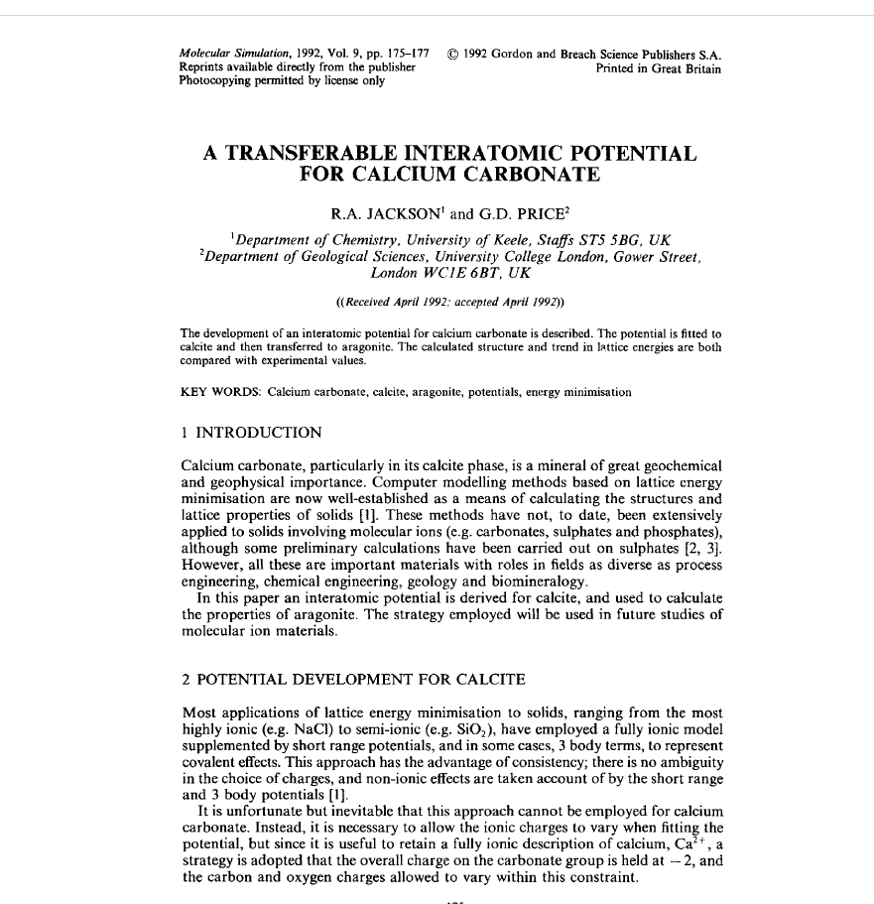
Previous modelling studies on carbonates
Carbonites have been widely modelled. An early study, on CaCO₃ from our group is shown, although there have been many other papers on this subject.
In this paper an interatomic potential for the calcite phase of CaCO₃ was derived and applied to modelling the aragonite phase.

Slide 6
Methodology – 1. Potentials
Materials are modelled by potentials fitted to structures (and properties, when available).
The Buckingham potential is used, supplemented by an electrostatic term. Ionic polarisability can be included via the shell model.
V(r) = q₁q₂/r + A exp (-r/ρ) – Cr⁻⁶
For example, results of fitting to CaCO₃ crystal structure (Jackson & Price 1992, slide 5):
Lattice Parameter Exp. Value Calc. value % difference
a=b (Å) 4.990000 4.912984 -1.54
c (Å) 17.002000 17.502982 2.95
γ (°) 120.0 120.0 0.0

Slide 7
Methodology – 2. Lattice energy minimisation
Lattice energy minimisation is used to model structures once a potential has been derived.
The lattice energy (LE) of a crystal is defined as the sum of the interactions between its constituent ions.
Hence, we can write: LE = Σ (Buckingham potentials) = Σ (V(r))
The experimentally determined structure should correspond to the structure with the minimum lattice energy.
The minimisation process corresponds to systematic variation of the structural parameters.

Slide 8
Methodology – 3. Software
All calculations were performed using the GULP code, written by Julian Gale (Curtin, Australia).
The code is free to download for academic use and can be obtained from here:
https://gulp.curtin.edu.au/download.html
A journal reference is given here:
J D Gale, J. Chem. Soc., Faraday Trans., 1997, 93(4), 629-637

Slide 9
Mean field calculations
These are perfect lattice calculations in which the occupancy of a dopant ion at a lattice site is steadily increased.
They enable the average effect of doping on lattice parameters etc. to be calculated.
If the dopant cation is not the same charge as the ion it is substituting, vacancies or interstitials are introduced by increasing or decreasing the anion charge to ensure a neutral unit cell.
To model dolomite, we started with the CaCO₃ structure, and progressively substituted Mg at the Ca site.

Slide 10
Mean field calculations on calcite - dolomite
% of ion in CaCO₃ | a=b / Å | c / Å
0 | 4.99 | 17.061
10 | 4.91 | 17.474
20 | 4.907 | 17.443
30 | 4.903 | 17.411
40 | 4.900 | 17.377
50 | 4.896 | 17.341
60 | 4.892 | 17.303
70 | 4.888 | 17.262
80 | 4.883 | 17.219
90 | 4.877 | 17.173
100 | 4.872 | 17.122
The 50% concentration corresponds to the dolomite structure

Slide 11
Comparison of mean field and experimental structures
An experimental structure from a natural sample was obtained by Effenberger et al, Zeischrift fur Kristallographie 156, 233-243 (1981). The table below compares this with the mean field structure:
This shows that the mean field method is a reliable method for predicting the dolomite structure, and can be applied to other similar materials.
Source | a=b / Å | c / Å
Mean field | 4.8965 | 17.3416
Expt. (Effenberger et al) | 4.8168 | 16.6855

Slide 12
Acknowledgements
I would like to thank Dr Michael Montenari (School of Geography, Geology & the Environment, Keele University) for introducing me to the dolomite problem.
Ryan Vegad carried out this work as part of his final year Chemistry project, and we thank Keele University for the provision of computing resources.
Thank you to the conference organisers for the invitation to present this paper!

Slide 13
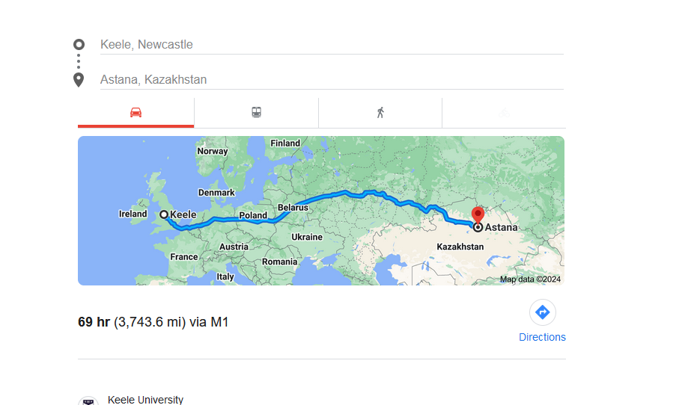
Geography!

Slide 14


