Slide 1

COMPUTER MODELLING OF INTRINSIC DEFECTS AND Th INCORPORATION IN MgF₂: WHAT WE CAN LEARN FROM ATOMISTIC MODELLING AND DFT APPROACHES
Robert A Jackson
School of Chemical & Physical Sciences, Keele University, Keele, Staffs ST5 5BG, UK
Mário E G Valerio
Department of Physics, Federal University of Sergipe, 49.100-000 São Cristóvão, Brazil

Slide 2
Plan for talk
Background and motivation – nuclear clocks
Previous work – modelling Th in LiCaAlF₆/LiSrAlF₆ & CaF₂
Moving to MgF₂
  Potential derivation
  Defect calculations
Modelling Th in MgF₂
Comparison with DFT study
Conclusions

Slide 3
Background and motivation: nuclear clocks
This study originated when I was approached by two research groups who were developing nuclear clocks by embedding the 229 isotope of Th into transparent crystals.
²²⁹Th is being investigated for use in ‘nuclear clocks’; its first nuclear excited state is (unusually) only ~ 8 eV above the ground state, and can be probed by VUV radiation.
  These promise up to 6 orders of magnitude improvement in precision over next generation atomic clocks, as well as enhanced stability.

Slide 4
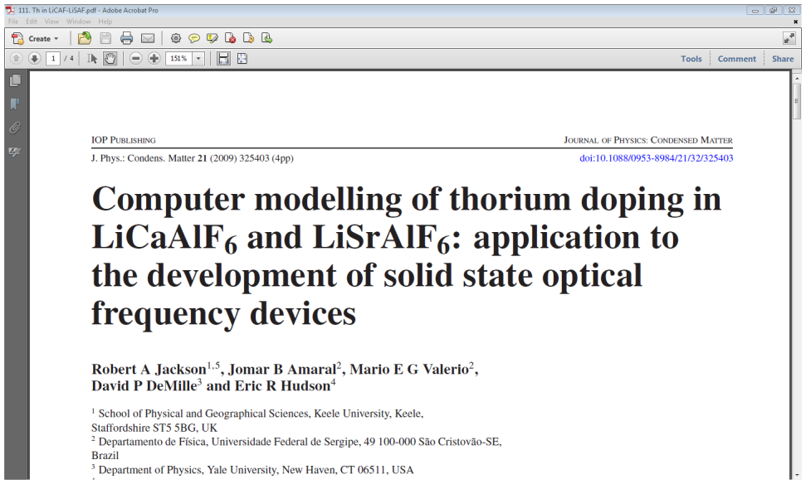
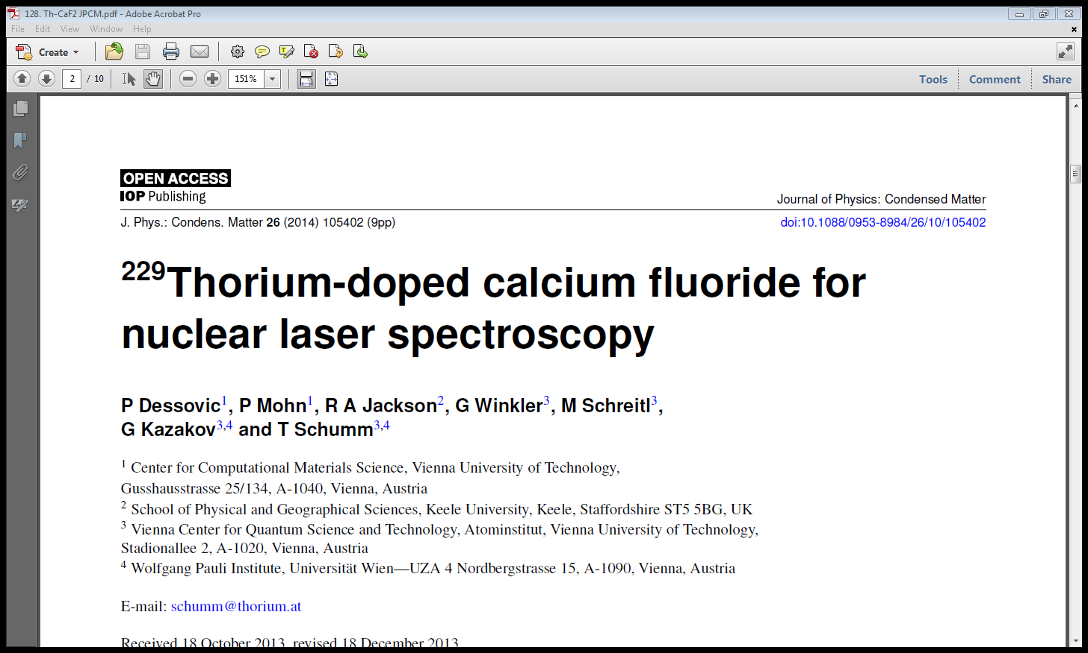
Previous work – modelling Th in LiCaAlF₆/LiSrAlF₆ & CaF₂
Th⁴⁺ has to be doped into a suitable crystal; LiCaAlF₆/LiSrAlF₆ and CaF₂ have been investigated.
Two previous papers (below) have modelled Th⁴⁺ in these materials, and established the energetically favoured dopant sites and charge compensation mechanism.

Slide 5
Solution schemes for Th⁴⁺ incorporation in LiCaAlF₆/LiSrAlF₆ & CaF₂
LiCaAlF₆
x ThF₄ + (1-x) CaF₂ + LiF + AlF₃ → LiTh_{x}Ca_{1-x}AlF_{6+2x}
CaF₂
x ThF₄ + (1-x) CaF₂ → Ca_{1-x}Th_{x}F_{2+2x}
The lowest energy solution scheme involves Th⁴⁺ substituting at the Ca²⁺ site with charge compensation by 2 F⁻ interstitials, and in the CaF₂ study both atomistic modelling and DFT confirmed this.

Slide 6
Moving to MgF₂
Attention moved to MgF₂ because it is apparently easier to work with experimentally.
MgF₂ has been modelled atomistically before:
  Cormack et al (1989)* calculated defect formation and ion migration energies using formal charge potentials; in contrast Barrera et al (1997)* used a partial charge model, and concentrated on structural properties at elevated temperatures and high pressures.
  A formal charge model is needed in this case, and we did some minor refitting of the Cormack potential to improve structural agreement.
* References in proceedings paper

Slide 7
Derived potential
Interaction A (eV) ρ (Å) C (eV Å⁶)
Mg-F 1200.0 0.2664 0.0
F-F 1127.7 0.2753 15.8
Y_{F} = -1.59 |e|, k = 20.77 eV Å ⁻²
The potential for Th-F was transferred from the previous paper on Th in CaF₂ (Dessovic et al, 2014).

Slide 8
Structural agreement
Table 2: Comparison of experimental (Baur (1976)) and predicted structures
Experimental (Å) Calculated (Å) % difference
a = b 4.6213 4.5312 -1.95
c 3.0519 3.0906 1.27
The normal criteria of % agreement of 2% or better is achieved.

Slide 9
Defect calculations: formation energies
Using the Mott-Littleton approximation and the GULP code, defect properties were calculated.
Defect (fractional coordinates) Formation energy (eV)
Mg vacancy (0.0, 0.0, 0.0) 25.71
Mg interstitial (0.5, 0.0, 0.0) -18.36
F vacancy (0.3029, 0.3029, 0.0000) 6.03
F interstitial (0.5, 0.0, 0.0) -1.87

Slide 10
Defect calculations: Frenkel & Schottky energies
Defect Formation energy per defect (eV)
MgF₂ Schottky (unbound) 2.38 (MgF₂ lattice energy = -30.65 eV)
Mg Frenkel (unbound) 3.68
Mg Frenkel (bound) 1.55
F Frenkel (unbound) 2.08
F Frenkel (bound) 1.54
In the table it can be seen that there is significant binding which reduces the formation energy of the defects. It also suggests that F Frenkel disorder is energetically favoured, which confirms that F Frenkel interstitials are likely to be found.

Slide 11
Modelling Th in MgF₂ – solution schemes
Assuming that the Th⁴⁺ ion dopes at the Mg²⁺ site, there will be a charge imbalance of +2, which has to be made up by charge compensation. Possibilities are Mg²⁺ vacancy formation (i), or the formation of two F⁻ interstitials (ii).
(i) ThF₄ + 2 Mg_{Mg} -> Th_{Mg}•• + V_{Mg}’’ + 2MgF₂
(ii) ThF₄ + Mg_{Mg} -> Th_{Mg}•• + 2F_{i}’ + MgF₂

Slide 12
Modelling Th in MgF₂ – solution energy expressions
The corresponding expressions for calculating the solution energies for (i) and (ii) are:
E_{sol} = - E_{latt} (ThF₄) + E (Th_{Mg}•• ) + E (V_{Mg}’’) + 2 E_{latt} (MgF₂)
E_{sol} = - E_{latt} (ThF₄) + E (Th_{Mg}••) + 2 E (F_{i}’) + E_{latt} (MgF₂)
It should be emphasised that solution energies, rather than defect formation energies, are needed to be able to predict energetically preferred doping mechanisms.

Slide 13
Unbound solution energies for Th doping
Unbound solution energies are calculated by adding the defect formation energies obtained separately
Charge compensation scheme Solution energy per defect (eV)
Mg vacancy (0.5, 0.5, 0.5), unbound 3.82
F interstitials (0.5, 0, 0), (0.5, 1, 1) unbound 2.94
Without taking defect binding energies into account, the F interstitial scheme is favoured; however binding should be included.

Slide 14
Bound solution energies
To obtain bound solution energies, the Th at the Mg site plus the charge compensating defect are calculated together.
Charge compensation scheme Solution energy per defect (eV)
Mg vacancy (0.5, 0.5. 0.5) 2.33
F interstitials at (0.5, 1, 0), (0.5, 1, 1) -1.95*
F interstitials at (0.5, 0, 0), (0.5, 1, 1) -1.95*
F interstitials at (0.5, 1, 1), (0.5, 0, 1) -1.95*
* Most negative values chosen – full results in proceedings paper

Slide 15
Conclusions from atomistic calculations
The atomistic calculations suggest that the preferred charge compensation scheme involves formation of 2 F interstitials, which is also the preferred scheme for CaF₂ and LiCaAlF₆/LiSrAlF₆.
We now compare this prediction with that of a recent paper using DFT.

Slide 16
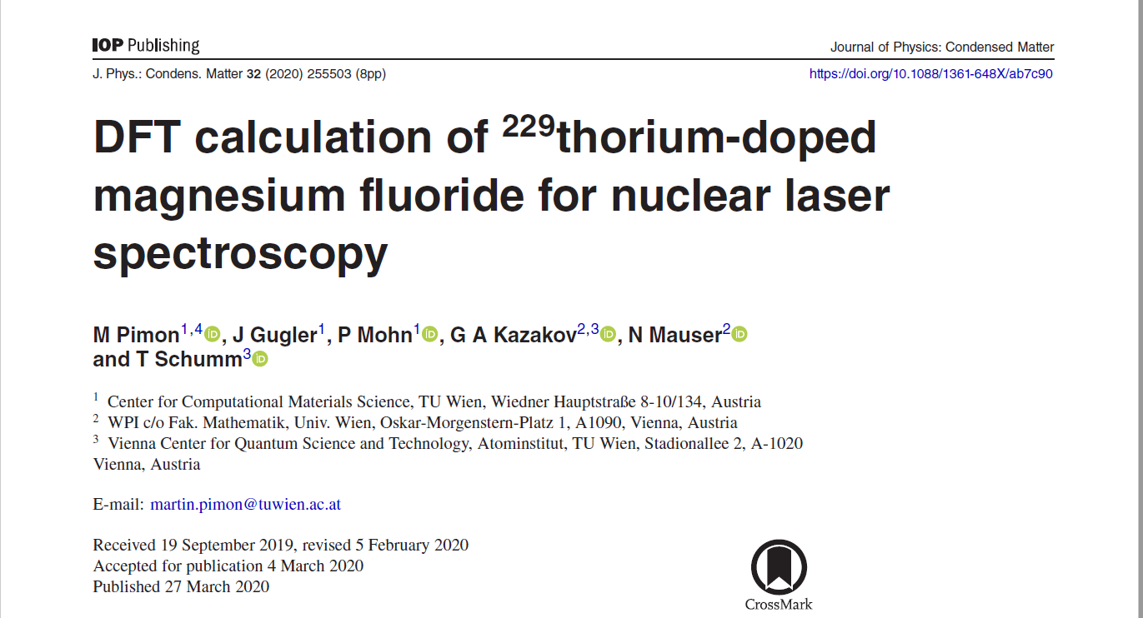
Recent DFT study of Th in MgF₂

Slide 17
Discussion of this paper
The background to the publication of this paper is that it was originally intended to be a joint atomistic/DFT study like the 2014 paper on Th in CaF₂ (see slide 4).
The conclusion of the paper is that Mg vacancy compensation is predicted.
Since the predictions of these calculations seemed to differ from the atomistic ones, the authors decided to publish their work. It is worth trying to analyse why the two methods produce different predictions.

Slide 18
Predictions from the DFT paper (i)
The paper does not include a table giving structural agreement (and it is not clear if the structure was optimised).
The functional used in the calculations calculates a band gap of 7.62 eV, in comparison with an experimental value of 12.4 eV, but it is accepted that band gaps are hard to predict reliably (the paper has more details on this).
The most important comparison is for the energies involved in the different charge compensation schemes.

Slide 19
Predictions from the DFT paper (ii)
Table 3 in the paper gives a comparison of various different types of charge compensations and their ground state energies E, as well as effect on the band gap.
The ground state energies are given relative to the lowest, for Mg vacancy compensation, and are summarised below:
Mg vacancy compensation | 0.0
F interstitial compensation (0.5, 1, 0), (0.5, 1, 1) | 0.89
F interstitial compensation (0.5, 0, 0), (0.5, 1, 1) | 0.95
F interstitial compensation (0.5, 1, 1), (0.5, 0, 1) | 0.93

Slide 20
Predictions from the DFT paper (iii)
The main point is that it appears that these calculations are probably for defect formation energies and not solution energies, so they do not take into account the other energies involved in the doping process. It is also interesting that the F interstitial compensation energies are all different, although they have the same symmetry crystallographically.
To try to compare the same energies, we have extracted the defect formation energies from our calculations and give them on the next slide:

Slide 21
Defect formation energies for Th doping
Charge compensation scheme
F interstitials at (0.5, 1, 0), (0.5, 1, 1) -70.62 eV (-23.54 eV/defect)
Mg vacancy (0.5, 0.5. 0.5) -14.03 eV (-7.02 eV/defect)
Defect formation energies also suggest the F interstitial scheme is more favourable (although as noted before, solution energies are strictly needed here).
So for a proper comparison, solution energies are needed for the DFT calculations!

Slide 22
Conclusions on comparison of methods
We believe that the issue here is that the predictions of the two methods are based on different models.
Solution energies are needed to make conclusive statements about doping sites.
Finally, the conclusion from the atomistic calculations, that the preferred charge compensation scheme involves F interstitials, is consistent with the results for CaF₂.
This is an important discussion since DFT methods are increasingly being used for calculations like these.

Slide 23
Overall conclusions
We have presented a modelling study on Th doping in MgF₂, and compared the results with a DFT study.
The reason for the difference in predictions has been discussed.
The paper can be discussed on the YouTube channel, or by email to: r.a.jackson@keele.ac.uk
The authors are pleased to contribute to this online conference, and thank all who have also taken part.

