Slide 1

Computer modelling of the concentration dependence of Th⁴⁺ ion doping in LiCaAlF₆ : preliminary results
Robert A Jackson and Helen A Watts
School of Chemical & Physical Sciences, Keele University, Keele, Staffs ST5 5BG, UK
Mário E G Valerio
Department of Physics, Federal University of Sergipe, 49.100-000 São Cristóvão, Brazil

Slide 2
Plan for talk
Background and motivation – nuclear clocks
Application of modelling in this project
Methodology employed
Previous work – modelling Th in LiCaAlF₆/LiSrAlF₆ & CaF₂
Supercell calculations: basic defects
Supercell calculations: Th doping
Conclusions

Slide 3
Background and motivation: nuclear clocks
This study originated when I was approached by two research groups who were developing nuclear clocks by embedding the 229 isotope of Th into transparent crystals.
They were interested in the energetically preferred location of Th in the crystal.
²²⁹Th is being investigated for use in ‘nuclear clocks’; its first nuclear excited state is (unusually) only ~ 8 eV above the ground state, and can be probed by VUV radiation.
These promise up to 6 orders of magnitude improvement in precision over next generation atomic clocks, as well as enhanced stability.

Slide 4
Applications of modelling
Atomistic modelling has been used to predict the lowest energy schemes for Th doping in host materials, including the charge compensating defects. This allows Th dopant sites to be predicted.
This information is useful with device applications in mind.
QM (usually DFT) calculations can be used to look at any effect on electronic and optical properties of charge compensating defects.
DFT has also been used to look at the relative energetics of different doping schemes, and agreement with atomistic modelling is important to achieve here – to be discussed later.

Slide 5
Methodology – 1. Potentials
Materials are modelled by potentials fitted to structures (and properties, when available).
The Buckingham potential is used, supplemented by an electrostatic term. Ionic polarisability can be included via the shell model.
V(r) = q₁q₂/r + A exp (-r/ρ) – Cr⁻⁶
Results of fitting to LiCaAlF₆ crystal structure:
Lattice Parameter Exp. Value Calc. value % difference
a=b (Å) 5.01 5.03 0.42
c (Å) 9.64 9.62 -0.24
γ (°) 120.0 120.0 0.0

Slide 6
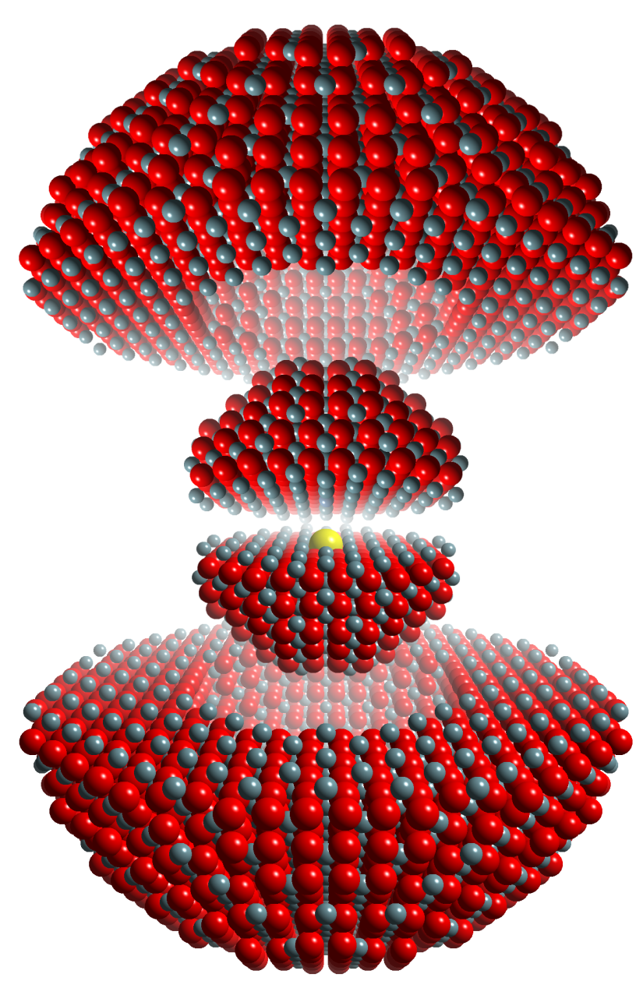
Methodology – 2. Defect calculations
Defects and dopants can be modelled in two ways:
Using the Mott-Littleton method (illustrated), which uses a two region approach (and models an infinitely dilute system).
Using supercells, where defects and dopants are placed directly in the cell, and concentration is explicitly included.
Diagram © Mark Read
The defect is embedded in an inner region which is treated explicitly, and surrounded by an outer region which is treated more approximately.

Slide 7
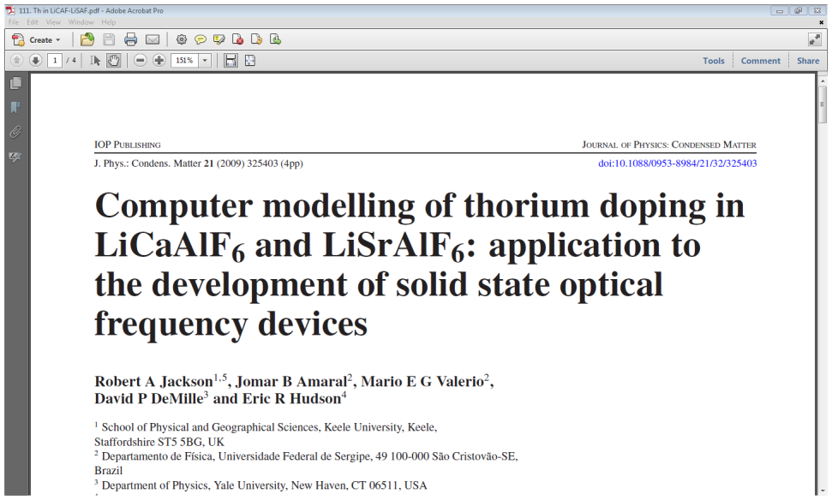
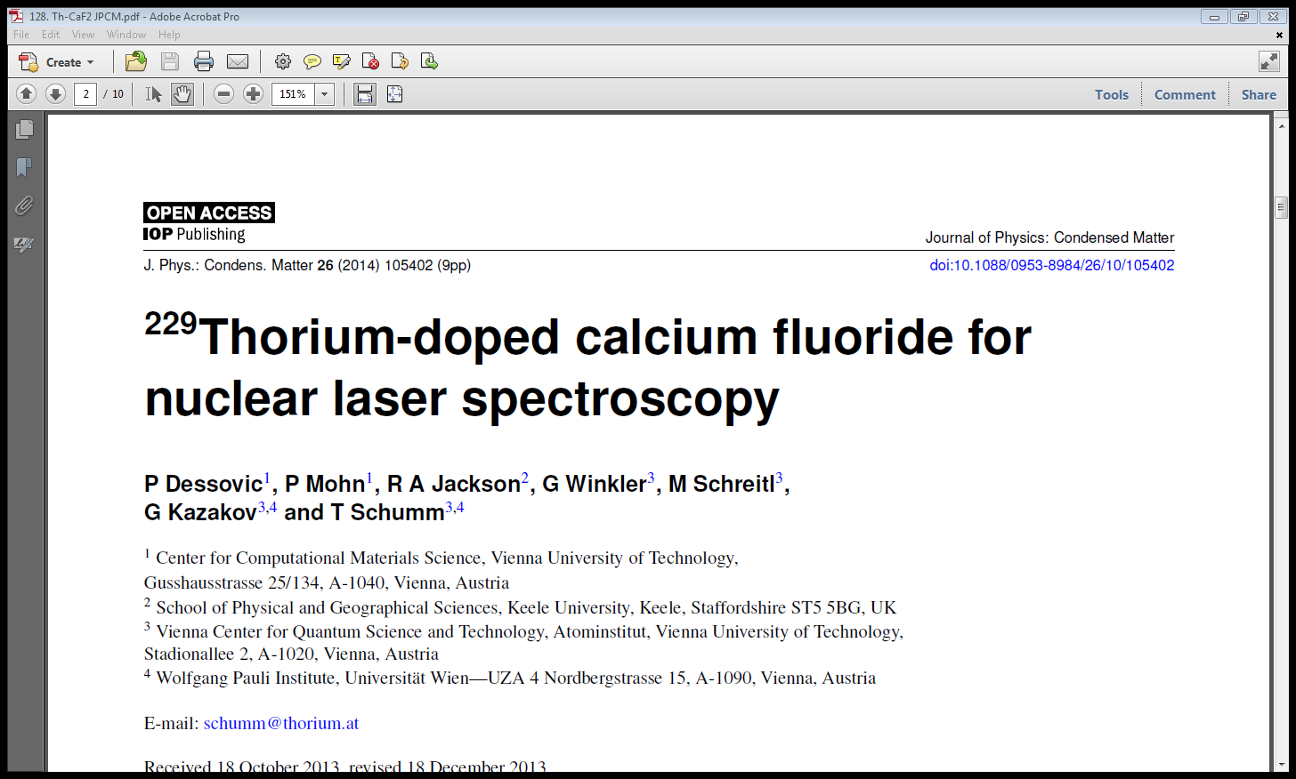
Previous work – modelling Th in LiCaAlF₆/LiSrAlF₆ & CaF₂
Th⁴⁺ has to be doped into a suitable crystal; LiCaAlF₆/LiSrAlF₆ and CaF₂ have been investigated.
Two previous papers (below) have modelled Th⁴⁺ in these materials, and established the energetically favoured dopant sites and charge compensation mechanism.

Slide 8
Solution schemes for Th⁴⁺ incorporation in LiCaAlF₆/LiSrAlF₆ & CaF₂
LiCaAlF₆
x ThF₄ + (1-x) CaF₂ + LiF + AlF₃ → LiTh_{x}Ca_{1-x}AlF_{6+2x}
CaF₂
x ThF₄ + (1-x) CaF₂ → Ca_{1-x}Th_{x}F_{2+2x}
The lowest energy solution scheme involves Th⁴⁺ substituting at the Ca²⁺ site with charge compensation by 2 F⁻ interstitials, and in the CaF₂ study both atomistic modelling and DFT confirmed this.

Slide 9
Solution energies for preferred doping locations (atomistic calculations)
For LiCaAlF₆, Th solution energies are in the range 0.83-1.00 eV for F interstitial compensation, and around 2.5 eV for Ca vacancy compensation.
For CaF₂, Th solution energies are in the range 0.47-0.67 eV for F interstitial compensation, and around 1.7 eV for Ca vacancy compensation.
So for both host materials, calculations predict that F interstitial compensation is favoured.
DFT calculations confirm this for CaF₂.

Slide 10
Moving forward – more comparison with DFT
We were encouraged by the agreement with DFT for Th-CaF₂
However, DFT appeared to predict different schemes for Th in MgF₂ (discussed in my ICDIM2020 presentation) and in LiCaAlF₆ (recent ongoing work in the Schumm group). What could be the cause?
Solution energies vs defect formation energies?
Are we calculating the same thing?
Concentration effects (Mott-Littleton (ML) vs supercells)?
DFT calculations are performed using supercells, so Th concentrations are finite as opposed to being infinitely dilute.
So, doing supercell calculations with atomistic potentials makes sense.

Slide 11
Preliminary results of supercell calculations on LiCaAlF₆
A (2x2x2) supercell was modelled (for comparison with the DFT results).
To confirm that the defect properties of LiCaAlF₆ are being modelled consistently, we calculated defect formation energies and compared them with ML results:
Agreement is ~5%
(might improve for a larger SC)
- need to repeat with larger cells
 | ML values (eV) | SC values (eV)
V’’_{Ca} | 23.23 | 21.91
V’’’_{Al} | 60.93 | 56.13
V’_{Li} | 8.32 | 8.08
V•_{F} | 6.39 | 6.05

Slide 12
(Very) preliminary results of supercell calculations on Th-LiCaAlF₆
Single Th occupancy in a 2x2x2 supercell:
F interstitial charge compensation: solution energy 2.91 eV
Ca vacancy charge compensation: solution energy 3.64 eV
Higher Th concentration:
2 Th + 2 Ca vacancy charge comp: solution energy 3.72 eV (per Th)
So these calculations suggest (i) that F interstitial mechanism is still preferred, and (ii) that increasing doping concentration increases doping cost. But larger cells and higher concentrations need to be tested …

Slide 13
Conclusions
So far, we are seeing agreement between the supercell and Mott-Littleton calculations, which doesn’t help in understanding the disagreement with DFT.
But we need to use larger supercells to enable higher dopant concentrations, and also look at different configurations of dopants in the supercells.
Further discussions with those carrying out the DFT calculations are needed.

Slide 14

Acknowledgements
My co-authors Mário Valerio and Helen Watts.
Eric Hudson (UCLA) and Thorsten Schumm (TUW) for introducing me to the nuclear clocks project, which rather like LiNbO₃, is a project which ‘keeps giving’.
Henk Vrielink and Dirk Poelman for masterminding this ‘two conference’ event.
Finally, thanks for listening!

Slide 15


