Slide 1
Computer modelling of double doped SrAl₂O₄ for phosphor applications
Robert A Jackson*, Lauren A Kavanagh and Rebecca A Snelgrove
School of Physical & Geographical Sciences
Keele University
Keele, Staffs ST5 5BG, UK
*r.a.jackson@keele.ac.uk
@robajackson

Slide 2
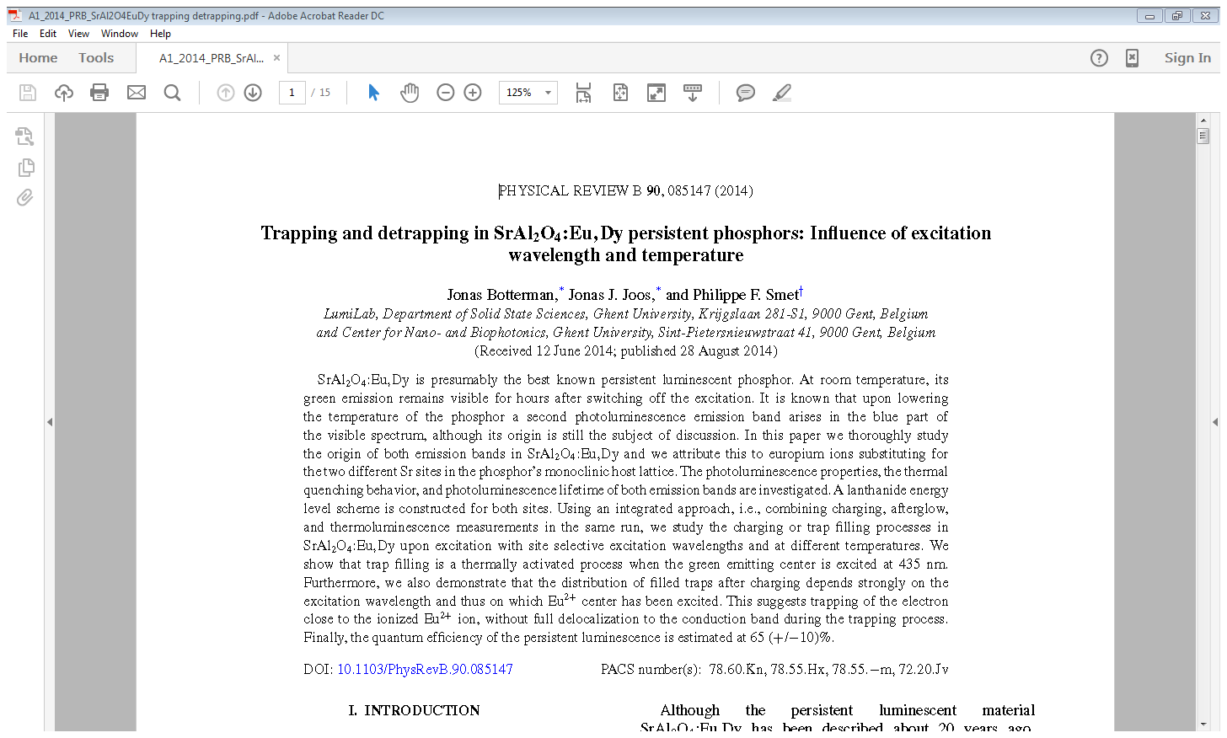
Motivation: paper based on presentation at EURODIM2014 by Philippe Smet

Slide 3
Plan of talk
Background to the research
Aim of the research
3. Outline of methodology
4. Results
Defect and solution energy calculations
Single doping
Double doping
Mean field calculations
5. Future work & conclusions
6. Acknowledgements & reminiscences

Slide 4
Background
SrAl₂O₄, when doped with Eu²⁺ and Dy³⁺ ions, behaves as a phosphor (the Dy³⁺ is found to enhance luminescence intensity).
It has many applications, e.g. in emergency signs.
SrAl₂O₄: Eu³⁺, Dy³⁺ synthesised by laser melting
After UV light exposure*
* ‘Laser Synthesis and Luminescence Properties of SrAl₂O₄: Eu²⁺, Dy³⁺ Phosphors’, Aroz et al, http://digital.csic.es/bitstream/10261/73706/4/Laser Synthesis.pdf

Slide 5
Aim of the research
To predict the optimal doping locations for Eu²⁺ and Dy³⁺ ions.
If, as suggested experimentally, Dy³⁺ substitutes at the Sr²⁺ site, how is the charge compensated?
Most of the experimental papers do not discuss this!
Is double doping energetically favourable?
What is the effect of dopant concentration?

Slide 6
Methodology
As in our previous work, use is made of interatomic potentials, energy minimisation and the Mott-Littleton method, using the GULP code*.
The structure of SrAl₂O₄ was modelled using potentials from http://www.ucl.ac.uk/klmc/Potentials/Library/catlow.lib
*http://nanochemistry.curtin.edu.au/gulp
 | Exp.** | Calc. | %***
a | 8.44365 | 8.49801 | 0.64
b | 8.82245 | 9.03433 | 2.40
c | 5.15964 | 5.25031 | 1.76
α=γ | 90.0 | 90.0 | 0.0
β | 93.411 | 92.425 | -0.99
**Avdeev et al, Journal of Solid State Chemistry (2007) 180, 3535-3544
***Differences of a few % are a compromise due to using transferred potentials.

Slide 7
Defect and solution energy calculations
Defect formation energies (including substitution energies) are calculated using the Mott-Littleton method (see opposite):
Solution energies give the energy involved in the total solution process, e.g. for Eu²⁺ at Sr site:
$$EuO+{Sr}_{Sr}→{Eu}_{Sr}+SrO$$
© Mark Read

Slide 8
Intrinsic defect formation energies and lattice energies
Calculations of Schottky and pseudo-Schottky energies have been performed:
*M Rezende MSc thesis,
(2008)
 | Energy/eV
Sr vacancy | 19.53
Al vacancy | 59.26
O vacancy | 25.16
E (latt) SrAl₂O₄ | -194.4
E (latt) SrO | -33.97
Schottky (per ion) | 6.325
SrO pseudo-Schottky (per ion) | 5.330
(O Frenkel (per ion) | 5.180)*

Slide 9
Single doping calculations – (i)
The experimental literature assumes doping of both Eu²⁺ and Dy³⁺ at the Sr²⁺ site (but doesn’t justify this in detail).
Not a problem for Eu²⁺ where no charge compensation is required: $EuO+{Sr}_{Sr}→{Eu}_{Sr}+SrO$
The average solution energy is 0.06 eV, confirming that doping with Eu²⁺ is favourable.
For Dy³⁺, what about substitution at the Al³⁺ site?
Assuming ${Dy}_{2}O_{3}+{2Al}_{Al}→{2Dy}_{Al}+{Al}_{2}O_{3}$
Solution energy is 1.72 eV (per Dy³⁺), which suggests the doping process at this site is favourable.

Slide 10
Single doping calculations – (ii)
For Dy³⁺ doping at Sr²⁺, charge compensation is required. We assume this occurs via Sr²⁺ vacancy compensation:
$${Dy}_{2}O_{3}+{2Sr}_{Sr}→{2Dy•}_{Sr}+{V′′}_{Sr}+3SrO$$
The calculated solution energy is 3.08 eV per Dy.
This suggests that single doping with Dy³⁺ at the Sr²⁺ site is less energetically favourable than if the ion substitutes at the Al³⁺ site, assuming charge compensation via Sr²⁺ vacancies.

Slide 11
Double doping calculations
For doping with Eu²⁺ and Dy³⁺, assuming the following scheme (both ions at Sr sites, Sr vacancies):
$${Dy}_{2}O_{3}+EuO +{4Sr}_{Sr}→{Eu}_{Sr}+{2Dy•}_{Sr}+{V′′}_{Sr}+4SrO$$
The solution energy per dopant ion is 2.08 eV
Double doping at the Sr²⁺ site is calculated to be more favourable than two stages of single doping.
However, it is still predicted that Dy³⁺ ions will substitute at the Al³⁺ site, unless an alternative charge compensation scheme occurs.

Slide 12
Comparison with an experimental study on M³⁺- doped SrAl₂O₄
‘Study on Optical Properties of Rare-Earth Ions in Nanocrystalline Monoclinic SrAl₂O₄: Ce³⁺, Pr³⁺, Tb³⁺’, Fu et al, J. Phys. Chem. B 2005, 109, 14396-14400
This paper looked at the effect of M³⁺ doping on SrAl₂O₄ lattice parameters.
Occupation of the Sr²⁺ site by M³⁺ was assumed (again!) with no discussion of charge compensation.

Slide 13
Mean field calculations
These are perfect lattice calculations in which the occupancy of a dopant ion at a lattice site is steadily increased.
They enable the average effect of doping on lattice parameters etc. to be calculated.
If the dopant cation is not the same charge as the ion it is substituting, vacancies or interstitials are introduced by increasing or decreasing the anion charge to ensure a neutral unit cell.

Slide 14
Mean field calculations on M³⁺- doped SrAl₂O₄
If the M³⁺ ions are substituted at the Al³⁺ site, the calculations suggest expansion of the lattice.
So mean field calculations were carried out to assess average effect of doping, assuming substitution at the Sr²⁺ site.
From the table:
Pure ‘a’ = 8.447 Å
Doped material | a/Å
SrAl₂O₄: Ce³⁺ | 8.431
SrAl₂O₄: Pr³⁺ SrAl₂O₄: Tb³⁺ | 8.432 8.441

Slide 15
Results of mean field calculations
The calculations show that the ‘a’ lattice parameter contracts on doping with M³⁺ ions.
In these calculations, the charge was compensated by increasing the O charge, suggesting a preferred charge compensation scheme might be based on O interstitials.
The graph shows ‘a’ lattice parameter for the system:
Sr_{1-x}M_{x}Al₂O_{4+x/2} as a function of x.
(Charge compensation by increased O charge.)

Slide 16
Future work and conclusions
The results obtained so far demonstrate that relatively simple solution energy calculations have a useful role in helping interpret and further explain experimental data.
However, charge compensation is important and needs to be considered more in experimental papers!
Future work will look at finite dopant concentrations, using methodology still being developed, as well as by supercell calculations.

Slide 17
Acknowledgements
I would like to thank:
My co-authors Lauren and Becky, both undergraduate students, who (without knowing it) are helping to keep my research alive (in austerity and pre-Brexit UK)!
Mário Valerio for many useful discussions over many years (32 years and counting!)
Christophe Dujardin and his team for organising this splendid conference.

Slide 18
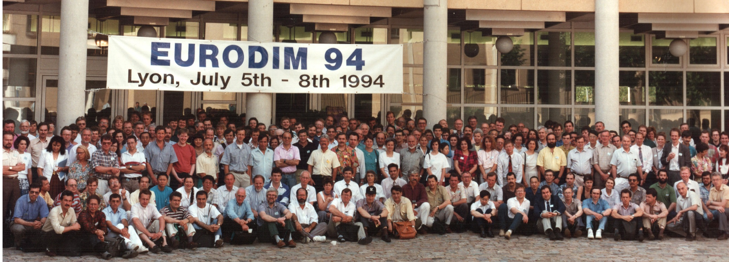
Reminiscences
The last ‘DIM’ conference in Lyon was in 1994. At that conference I was ‘assigned’ to organise the EURODIM 98 conference in Keele …

