Slide 1
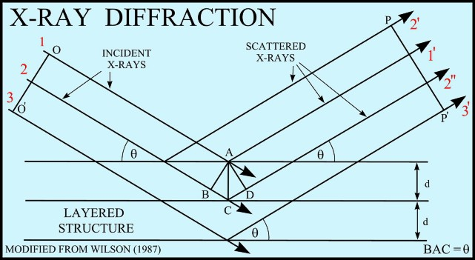
CHE-20031 (Structural Inorganic Chemistry) X-ray Diffraction & Crystallography lecture 3
Dr Rob Jackson
LJ1.16, 01782 733042
r.a.jackson@keele.ac.uk
www.facebook.com/robjteaching
Twitter: #che20031

Slide 2
X-ray Diffraction & Crystallography: lecture 3 plan
What have we covered so far?
Key points
Single crystal and powder diffraction
Simulated patterns
How to obtain positions of atoms
A further example of indexing a pattern (revision from lecture 2)

Slide 3
Key points from lectures 1 and 2
We can index an X-ray diffraction pattern to get the Miller indices and lattice parameters of a crystal.
The peak positions therefore enable us to calculate the crystal lattice parameters.
How do we get the atomic positions?

Slide 4
Measurements on single crystals
The data we have seen so far have come from single crystals.
However it is not always possible to grow perfect single crystals.
Samples are often in the form of powders.
A single crystal of CaF₂

Slide 5
What about powder samples?
Usually you don’t have single crystals to analyse.
Powder samples contain many small crystallites, of dimension 10⁻⁷ to 10⁻⁴ m, and they will be orientated randomly.
We still need the 2θ angles for each lattice spacing, but they are more difficult to measure..

Slide 6
Scattering an X-ray beam from a powder sample
The diagram shows an X-ray beam incident on a sample of randomly-orientated crystallites.

Slide 7
A real powder XRD pattern

Slide 8
Indexing powder patterns
The X-ray diffraction pattern on slide 7 can be indexed in the same way as the single crystal patterns we have seen, but some of the peaks may be less sharp, so harder to measure.
However, for powder patterns of many materials, library patterns are available for comparison.

Slide 9
Using library patterns
Using a pattern like the one on slide 7, experimental powder patterns can be compared with library patterns, and if identification is successful, automatic indexing is possible.
This information is obtained from the PDF (powder diffraction file) published by the International Centre for Diffraction Data:
http://www.icdd.com (the site will be shown)

Slide 10
A simulated powder XRD pattern
Intensity vs 2θ

Slide 11
How atom positions are obtained
For completeness, we need to consider how to get the atomic positions.
What information has not been used so far?
The atomic positions are obtained from the peak intensities, but the procedure involved is beyond the scope of this module.

Slide 12
Exercise: a further example of indexing a pattern for a cubic material
2θ | θ | sin²θ | ratio | hkl | a
38 | 19.0 | 0.11 | 3 | 111 | 4.05
45 | 22.5 | 0.15 | 4 | 200 | 4.02
66 | 33.0 | 0.30 | 8 | 220 | 4.02
78 | 39.0 | 0.40 | 11 | 311 | 4.04
83 | 41.5 | 0.45 | 12 | 222 | 4.02
99 | 49.5 | 0.58 | 16 | 400 | 4.04
113 | 56.5 | 0.70 | 19 | 331 | 4.03
118 | 59.0 | 0.73 | 20 | 420 | 4.04
139 | 69.5 | 0.88 | 24 | 422 | 4.01
168 | 84.0 | 0.99 | 27 | 511 | 4.03
Assign hkl values assuming the lowest ratio value is 3.
Calculate ‘a’ for each reflection and explain any differences in the values.
What is the lattice type?

