Slide 1

Computer modelling of materials: from nuclear fuels to nuclear clocks
Rob Jackson
Lennard-Jones Laboratories
School of Physical and Geographical Sciences
Keele University
Keele, Staffordshire ST5 5BG, UK
r.a.jackson@chem.keele.ac.uk, http://www.robjackson.co.uk

Slide 2
Contents and plan of talk
Computer modelling overview
  What is needed to model structures?
  Interatomic potentials, lattice energy minimisation.
Defects in materials
  Point defects, ion migration, dopants
Case studies
Future work
  Finite defect concentrations
  Quantum mechanical cluster modelling

Slide 3


Pre-acknowledgements
Tom Littleford, Scott Walker (Keele)
Mark Read, Dave Plant (AWE, UK)
Mário Valerio, Marcos Rezende (UFS, Brazil)
Eric Hudson (UCLA, USA), David DeMille (Yale, USA)

Slide 4
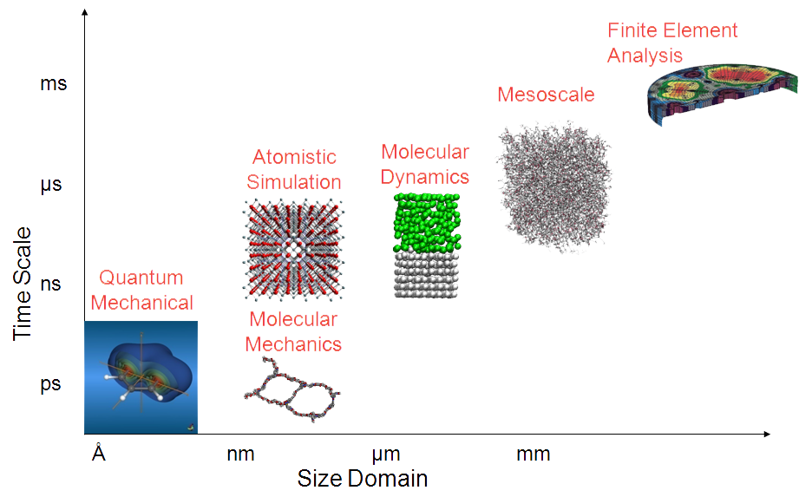
Role of Computational Chemistry, and where Materials Modelling ‘sits’
Computational Chemistry
Materials Modelling can:
Calculate material structures and properties.
Help explain/rationalise experimental data.
Predict material structures and properties.
Fundamental calculations to:
Predict parameters often unavailable from experiment.
Obtain ‘mechanistic’ information.

Slide 5
Current research interests
Modelling optical materials (e.g. YLiF₄, BaMgF₄)
  Predicting location/max. concentration of dopant ions
  Calculating and predicting optical transitions
Modelling ‘nuclear clock’ materials
  ²²⁹Th doping in LiCaAlF₆ (or CaF₂)
Modelling the structures of nuclear fuels (UO₂, PuO₂, MOX)
Modelling geological materials (e.g. zircon (ZrSiO₄) and related materials )
  ZrSiO₄ → USiO₄ → PbSiO₄

Slide 6
What is needed to model a structure?
In order to get started, we need:
  Atomic coordinates and cell parameters
  A description of the forces between the atoms in the structure (interatomic potentials)

Slide 7
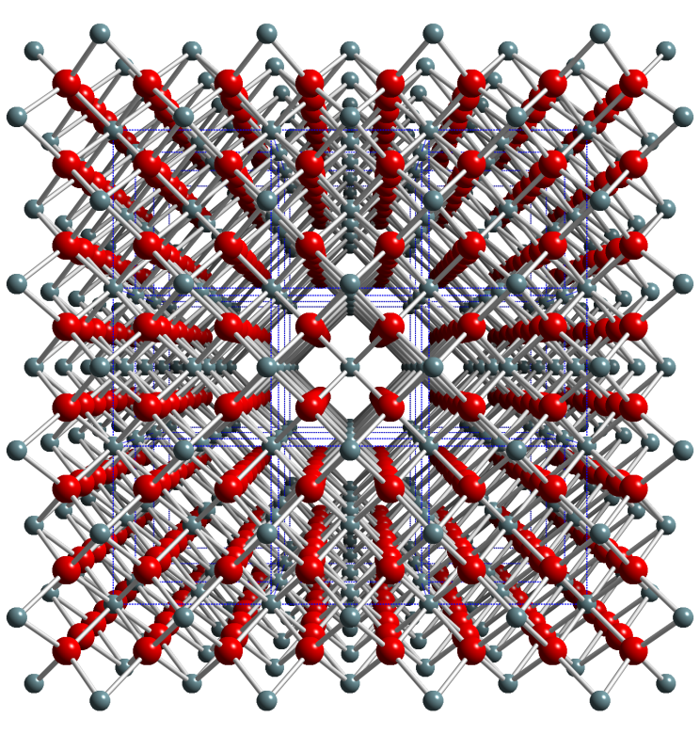
Example structure
Diagram shows the fluorite structure as adopted by CaF₂ and UO_{2.}
The structure is represented by its lattice parameters and the atomic coordinates.

Slide 8
Example GULP dataset extract: structural information
# UO2 Structure parameters obtained from:
# Barrett, S.A.; Jacobson, A.J.; Tofield, B.C. and Fender, B.E.F.
# Acta Crystallographica B (1982) 38, 2775-2781
cell
5.4682 5.4682 5.4682 90.0 90.0 90.0
fractional 4
U core 0.00 0.00 0.00 -2.54
U shel 0.00 0.00 0.00 6.54
O core 0.25 0.25 0.25 2.40
O shel 0.25 0.25 0.25 -4.40
space
225
lattice parameters
ionic coordinates
and charges
space group

Slide 9
Introduction to interatomic potentials
Interatomic potentials are simple mathematical functions that describe the interactions between atoms.
For ionic materials we are describing interionic interactions, and the Buckingham potential is usually used, supplemented by an electrostatic term:
V(r) =q₁q₂/r + A exp (-r/ρ) – Cr⁻⁶

Slide 10
Ion charges: rigid and polarisable ions
Ions can be given their formal charges, or …
  If the ions being modelled are polarisable (particularly the case for anions), they can be described by the Shell Model*, where each ion consists of a core and shell coupled by a harmonic spring. The charge is distributed between the core and shell.
* B G Dick, A W Overhauser, Phys. Rev. 112 (1958) 90–103

Slide 11
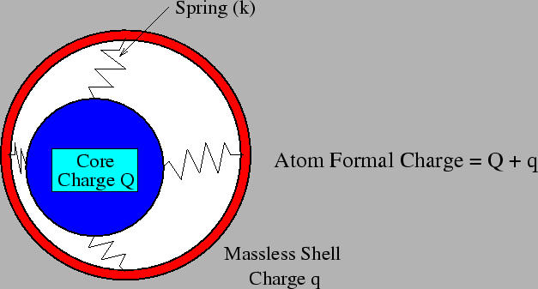
The shell model explained
Diagram taken from: http://tfy.tkk.fi/~asf/physics/thesis1/node23.html

Slide 12
Potential parameters
In the Buckingham potential, the parameters A, ρ and C must be provided, and they are normally obtained by empirical fitting. The q₁ and q₂ are charges of the interacting ions.
Empirical fitting involves varying the parameters until the minimum energy structure they predict corresponds to the experimental structure.

Slide 13
Fitting to crystal properties
By fitting a potential to a structure, we should obtain a potential which can reproduce at least the crystal structure and maybe the properties as well.
If experimental values of properties such as elastic and dielectric constants, or phonon modes, are available, they can be included in the fit.

Slide 14
Case study: potential fitting
An example of detailed potential fitting is available:
  M S D Read, R A Jackson, Journal of Nuclear Materials, 406 (2010) 293–303
In this paper, the potential is fitted to the structure and lattice properties of UO₂.
PDF copies of the paper are available – download from web site.

Slide 15
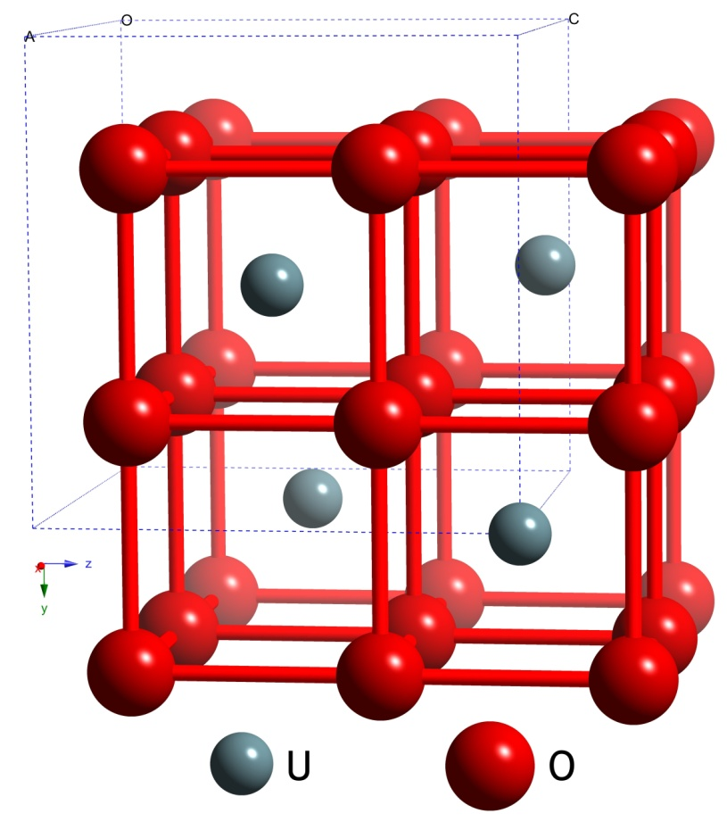
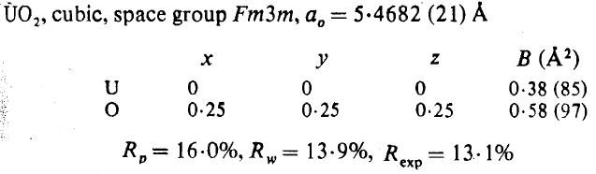
Experimental Data for Empirical Fitting
Elastic Constants / GPa
Reference | C₁₁ | C₁₂ | C₄₄
Dolling et al. [1] | 401 ± 9 | 108 ± 20 | 67 ± 6
Wachtman et al. [2] | 396 ± 1.8 | 121 ± 1.9 | 64.1 ± 0.17
Fritz [3] | 389.3 ± 1.7 | 118.7 ± 1.7 | 59.7 ± 0.3
Dielectric Constants
Reference | Static ε₀ | High Frequency ε∞
Dolling et al. [1] | 24 | 5.3
[1] G. Dolling, R. A. Cowley, A. D. B. Woods, Crystal Dynamics of Uranium Dioxide,
Canad. J. Phys. 43 (8) (1965) 1397–1413.
[2] J. B. Wachtman, M. L. Wheat, H. J. Anderson, J. L. Bates, Elastic Constants of Single Crystal UO₂ at 25°C, J. Nucl. Mater. 16 (1) (1965) 39–41.
[3] I. J. Fritz, Elastic Properties of UO₂ at High-Pressure,
J. Appl. Phys. 47 (10) (1976) 4353–4358.
S. A. Barrett, A. J. Jacobson, B. C. Tofield, B. E. F. Fender, The Preparation and Structure of Barium Uranium Oxide BaUO_{3+x}, Acta Cryst. 38 (Nov) (1982) 2775–2781.

Slide 16
Final GULP input dataset for UO₂
conp opti compare prop
# UO2 Structure parameters obtained from:
# Barrett, S.A.; Jacobson, A.J.; Tofield, B.C. and Fender, B.E.F.
# Acta Crystallographica B (1982) 38, 2775-2781
cell
5.4682 5.4682 5.4682 90.0 90.0 90.0
fractional 4
U core 0.00 0.00 0.00 -2.54
U shel 0.00 0.00 0.00 6.54
O core 0.25 0.25 0.25 2.40
O shel 0.25 0.25 0.25 -4.40
space
225
#potential from Read & Jackson, , Journal of Nuclear Materials, 406 (2010) 293–3
buck
U shel O shel 1025.53 0.4027 0.0 0.0 10.4
buck4
O shel O shel 11272.6 0.1363 134.0 0.0 1.2 2.1 2.6 10.4 0 0 0 0
spring
U core U shel 93.07
O core O shel 296.2

Slide 17
How good is the final fit?
Parameter | Calc. | Obs. | Δ% | Parameter | Calc. | Obs. | Δ%
Lattice Constant [Å] | 5.4682 | 5.4682 | 0.0 | C₁₁ [GPa] | 391.4 | 389.3 | 0.5
U⁴⁺ – U⁴⁺ Separation [Å] | 3.8666 | 3.8666 | 0.0 | C₁₂ [GPa] | 116.7 | 118.7 | -1.7
U⁴⁺ – O²⁻ Separation [Å] | 2.3678 | 2.3678 | 0.0 | C₄₄ [GPa] | 58.1 | 59.7 | -2.7
O²⁻ – O²⁻ Separation [Å] | 2.7341 | 2.7341 | 0.0 | Bulk Modulus [GPa] | 208.3 | 204.0 | 2.1
Static Dielectric Constant | 24.8 | 24.0 | 3.3 | High Frequency Dielectric Constant | 5.0 | 5.3 | -5.7
See: M S D Read, R A Jackson, Journal of Nuclear Materials, 406 (2010) 293–303

Slide 18
Lattice Energy Minimisation
Once potentials are fitted, structures can be determined.
The lattice energy (LE) of a crystal is defined as the sum of the interactions between its constituent ions.
Hence we can write:
LE = Σ (Buckingham potentials) = Σ (V(r))
The principle behind lattice energy minimisation is that the structure is varied until a minimum value of the LE is obtained.

Slide 19
Summary: potentials and lattice energy minimisation
Potentials are fitted to crystal structures (and crystal properties, if available).
Minimum energy structures are then obtained.
Provided structures are accurately reproduced, we can go on to model defects in crystal structures.

Slide 20
Defects in materials
We are mainly interested in:
  Calculation of energies of formation of defects
  Modelling ion migration
  Modelling doping in crystals
    Calculating substitution and solution energies
    Determining location of dopants
    Determining dopant concentrations (new)

Slide 21
Point defects and defect clusters
The basis of the method used to calculate the formation energy of point defects and defect clusters is the Mott-Littleton Approximation.
  NF Mott, MJ Littleton, Trans. Faraday Soc., 1938, 34, 485
A special journal issue was published 50 years after this paper:
  Faraday Trans. II, 1989, 85, 335-579

Slide 22
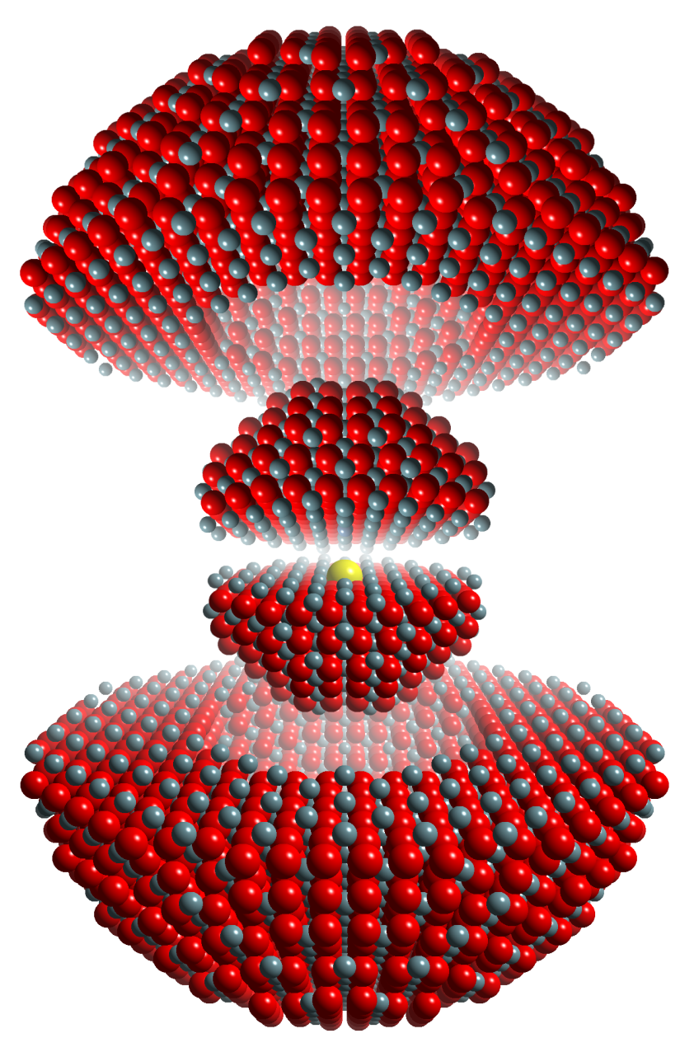
Mott-Littleton approximation
© Mark Read (AWE)
Region I
Ions are strongly perturbed by the defect and are relaxed explicitly with respect to their Cartesian coordinates.
Region II
Ions are weakly perturbed and therefore their displacements, with the associated energy of relaxation, can be approximated.
Defect
Region I
Region IIa

Slide 23
Calculating defect formation energies and activation energies for ion migration
Using the ML approximation, and the GULP code, we can calculate the energies of formation of vacancies and interstitials in a material.
Ion migration can also be modelled, by calculating the energy of an ion at the midpoint between two vacancies (for the vacancy mechanism).

Slide 24
Dopants in crystals
We may be interested in calculating the energy involved in substituting a different ion in a structure (where that ion adds functionality, e.g. thorium in CaF₂))
We will consider the process of substitution, and calculation of the substitution energy and the solution energy.

Slide 25
Substitution and solution energies
Substitution energies are the energies involved in substituting an ion into the material, but they do not take into account all the energetic terms involved in the solution process.
Solution energies include all these terms, so they can be used to determine where the ion will substitute, and what form of charge compensation will occur (if it is needed).

Slide 26
Case study: modelling Th⁴⁺ in LiCaAlF₆*
Aim: to illustrate all the steps covered with an example, and to relate it to the work on Th⁴⁺ in CaF₂ being performed at this institution.
  Derive and test potential for LiCaAlF₆.
  Derive and test potential for ThF₄.
  From defect calculations, determine preferred location of Th⁴⁺, and the charge compensation involved.
* Journal of Physics: Condensed Matter 21 (2009) 325403

Slide 27
1. Modelling LiCaAlF₆*
A potential was fitted to the LiCaAlF₆ structure; parameters are given in the reference below.
Good structural agreement was obtained:
*Journal of Physics: Condensed Matter 15 (2003) 2523–2533
Parameter | Experimental | Calculated | % difference
a = b (Å) | 5.01 | 5.03 | 0.42
c (Å) | 9.64 | 9.62 | -0.24
γ (deg) | 120.0 | 120.0 | 0.0

Slide 28
2. Modelling ThF₄
A potential was fitted to the ThF₄ structure:
[1] G Benner and B G Mueller, Zeitschrift für Anorganische und Allgemeine Chemie 588 (1990) 33-42
Potential parameters are given in the 2009 JPCM reference

Slide 29
3. Where does Th substitute in LiCaAlF₆?
Whichever cation site the Th⁴⁺ ion substitutes at, charge compensation will be needed.
10 possible reaction schemes are considered, and solution energies calculated for each one.
The lowest energy scheme involves substitution at the Ca²⁺ site, with charge compensation by 2 fluorine interstitial ions:
  ThF₄ + Ca_{Ca} → Th_{Ca}.. + 2F_{i}’ + CaF₂

Slide 30
Solution energies (eV) for different solution schemes
Charge compensation by vacancies
1.95 | 1.96 | 2.84 | 2.15 | 1.20 | 1.47 | 1.95
Charge compensation by interstitials
½ ½ 0 | ½ 0 0 | ¼ ¼ 0 | ¾ ½ 0 | ½ ½ 0 ½ 0 0 | ½ ½ 0 ¼ ¼ 0 | ½ ½ 0 ¾ ½ 0 | ½ 0 0 ¼ ¼ 0 | ½ 0 0 ¾ ½ 0 | ¼ ¼ 0 ¾ ½ 0
2.36 | 2.43 | 2.46 | 2.24 | 0.97 | 1.00 | 0.83 | 1.08 | 0.98 | 0.96

Slide 31
Conclusions on case study
From solution energy calculations, Th⁴⁺ is predicted to substitute at the Ca²⁺ site, with charge compensation by fluorine interstitials.
This is an important result because of the possible effects of charge compensating defects on the optical properties of the doped material.
Crystal growth is in progress, using ²³²Th initially.

Slide 32
Future work (i):
Concentration dependence of doping
As well as understanding where dopants are located in crystals, it is also useful to know the maximum concentration of dopant possible.
A method has recently been developed to do this, and applied to rare earth doping in several materials, including BaAl₂O₄.
Some results are shown on the next slide:

Slide 33
Concentration dependence of RE doping in BaAl₂O₄
We can calculate solution energies for M³⁺ ions in BaAl_{2-x}M_{x}O₄ as a function of x:
  Energies in eV, T = 293 K
 | 1% M₂O₃ | 2% M₂O₃ | 3% M₂O₃ | Max. x M₂O₃
Ce | -0.8466 | 1.0969 | 3.0404 | 1.4356
Pr | -0.8426 | 1.1048 | 3.0522 | 1.4327
Nd | -0.8416 | 1.1068 | 3.0552 | 1.4319
Sm | -0.8394 | 1.1112 | 3.0618 | 1.4303

Slide 34
Future work (ii):
QM modelling of doped materials
We would like to be able to use QM cluster calculations to study the electronic transitions of the dopant ions.
This is still ‘work in progress’ due to issues with codes and ‘person-power’, but I hope to be able to report on it in the future!
Thanks for your attention!

Slide 35


