Slide 1
Computational Solid State Chemistry 2
SSI-18 Workshop 2011
Rob Jackson
www.robjackson.co.uk
r.a.jackson@chem.keele.ac.uk

Slide 2
Contents and Plan
Modelling defects and dopants in ionic crystals
Calculation of energies of formation of defects in crystals
Modelling ion migration
Doping: substitution and solution energies

Slide 3
Defects: revision
We are usually interested in studying the formation of:
Vacancies
Interstitials
Substitutional defects (e.g. Dopants)
Point defects and defect clusters
Finite defect concentrations

Slide 4
Point defects and defect clusters
The basis of the method used to calculate the formation energy of point defects and defect clusters is the Mott-Littleton Approximation.
NF Mott, MJ Littleton, Trans. Faraday Soc., 1938, 34, 485
A meeting was held in 1988 to mark 50 years since the publication of the paper!
Faraday Trans. II, 1989, 85, 335-579

Slide 5
N F Mott

Slide 6
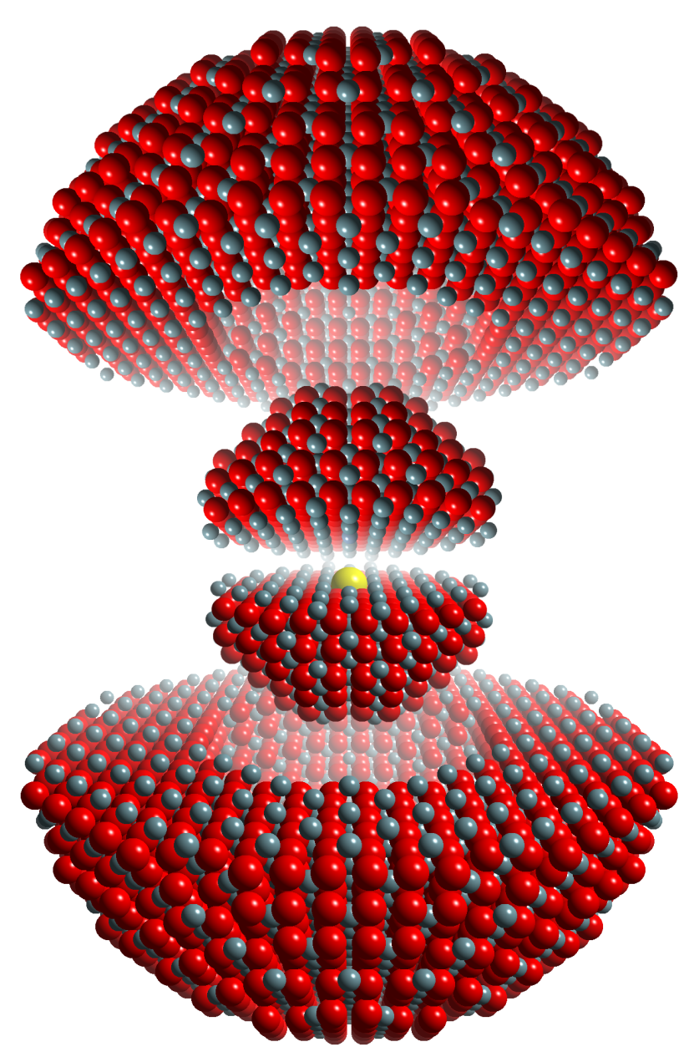
Mott-Littleton approximation
© Mark Read (AWE)
Region I
Ions are strongly perturbed by the defect and are relaxed explicitly with respect to their Cartesian coordinates.
Region II
Ions are weakly perturbed and therefore their displacements, with the associated energy of relaxation, can be approximated.
Defect
Region I
Region IIa

Slide 7
Calculating the formation energy of defects in ionic crystals – (i)
Using the Mott-Littleton Approximation, the radii of regions I and IIA are specified (in Å), and the centre of the defect.
In GULP this is done as follows (in UO₂):
size 10 15
centre 0.0 0.0 0.0
vacancy 0.0 0.0 0.0
This will create a vacancy at the O site.

Slide 8
Calculating the formation energy of defects in ionic crystals – (ii)
Running the GULP program with this information added to the basic dataset (from part 1), plus a few modifications to the initial keywords, will calculate the formation energy of an oxygen vacancy in UO2
Defect clusters are treated in a similar way, except that the centre of the cluster can be specified.

Slide 9
GULP dataset for oxygen vacancy calculation in UO₂
conp opti compare prop defe regi
# UO2 Structure parameters obtained from:
# Barrett, S.A.; Jacobson, A.J.; Tofield, B.C. and Fender, B.E.F.
# Acta Crystallographica B (1982) 38, 2775-2781
cell
5.4682 5.4682 5.4682 90.0 90.0 90.0
fractional 4
U core 0.00 0.00 0.00 -2.54
U shel 0.00 0.00 0.00 6.54
O core 0.25 0.25 0.25 2.40
O shel 0.25 0.25 0.25 -4.40
space
225
# U-O potential from Read & Jackson , Journal of Nuclear Materials, 406 (2010) 293–303
buck
U shel O shel 1027.6 0.4026 0.0 0.0 15.0
buck4
O shel O shel 11272.6 0.1363 134.0 0.0 1.2 2.1 2.6 15.0
spring
U core U shel 110.75
O core O shel 296.2
vacancy 0.25 0.25 0.25
size 10 15
centre 0.25 0.25 0.25

Slide 10
Modelling ion migration – (i)
For example, in solid electrolytes, ions can migrate via the vacancy mechanism, whereby an ion moves into a neighbouring vacant site, creating a vacancy which is then available for another ion to move into.
This can be modelled by having two vacancies, with the migrating ion represented by an interstitial ion.

Slide 11
Modelling ion migration – (ii)
The migration pathway can be modelled by moving the ion between the two vacancies, or the saddle point (usually the mid point) configuration can be calculated.
For O migration in UO₂ :
centre 0.25 0.0 0.0
vacancy 0.0 0.0 0.0
vacancy 0.5 0.0 0.0
interstitial O 0.25 0.0 0.0
Note that the migrating ion must be
identified

Slide 12
Calculating activation energies for ion migration
Once the energy of the saddle point configuration has been calculated, the activation energy for ion migration is calculated from:
Activation energy = saddle point energy – vacancy formation energy
This energy can be compared with experimental energies.

Slide 13
Dopants in crystals
We may be interested in calculating the energy involved in substituting a different ion in a structure (where that ion adds functionality, e.g. in optical/sensor materials, or in YSZ (Y stabilised ZrO₂))
We will consider the process of substitution, and calculation of the substitution energy and the solution energy.

Slide 14
Introducing dopants – (i)
To introduce dopants into the structure, the impurity keyword is used in GULP.
In UO₂, consider substituting a Pu (4+) ion at the U site:
centre 0.25 0.25 0.25
impurity Pu 0.25 0.25 0.25
In this case the charges are the same, so no charge compensation is needed.

Slide 15
Introducing dopants – (ii)
If there is a charge difference between the substituting and substituted ion, a charge compensating defect has to be included.
This can be done as a separate calculation, or the defect can included in the calculation as part of a defect cluster.
Consider substituting a Mg (2+) ion into the UO₂ structure (at the U site):

Slide 16
How charge compensation is included
In this case we could calculate the substitution energy from:
centre 0.25 0.25 0.25
impurity Mg core 0.25 0.25 0.25
Charge compensation could be via a O²⁻ vacancy; this energy could be calculated separately or included as an extra line:
vacancy 0.0 0.0 0.0

Slide 17
Substitution and solution energies
Substitution energies do not give information about trends, since they do not take into account all the energetic terms involved in the solution process.
We will consider the 2 cases already mentioned, and list all the energy terms involved.
Expressions for the solution energy (E_{sol}) will be obtained.

Slide 18
(i) Pu in UO₂
Start with the oxide PuO₂, and mix it with UO₂.
Term 1: - E_{latt} (PuO₂) (produces ions of Pu⁴⁺ and O²⁻)
Term 2: substitution energy, E_{subs} (Pu_{U}) (from GULP)
Term 3: E_{latt} (UO₂) (the displaced U ion and the O combine)
The solution equation is then:
PuO₂ + U_{U} → Pu_{U} + UO₂
E_{sol} = - E_{latt} (PuO₂) + E_{subs} (Pu_{U}) + E_{latt} (UO₂)

Slide 19
(ii) Mg in UO₂
We follow a similar procedure to (i), but this time the vacancy formation energy term is included.
Solution equation:
MgO + U_{U} → Mg″_{U} + V••_{O} + UO₂
Solution energy expression:
E_{sol} = - E_{latt} (MgO) + E_{subs} (Mg″_{U}) + E (V••_{O} ) + E_{latt} (UO₂)
Note: Kroger-Vink
notation employed

Slide 20
Bound and unbound defects
In case (ii), the solution energy can be calculated using values of the substitution and vacancy formation energies calculated separately or together.
In the second case, the defect binding energy is included in the calculation.
Tables of bound and unbound solution energies can be found in papers.

Slide 21
Finite defect concentrations
When considering doping, it is useful to be able to consider solution of more than one dopant ion in an infinite lattice (which is what has been presented so far).
A new method has been developed which enables solution energies to be calculated as a function of dopant concentration.
This will be presented in my talk tomorrow!

Slide 22
Conclusions for part 2
Defects have been briefly revised.
The procedure for calculating point defect formation energies has been explained.
The calculation of activation energies for ion migration has been explained.
The calculation of substitution energies has been explained, and solution energies introduced.

