Slide 1
Computer Modelling of Materials for Optical and Energy Applications
http://www.robajackson.com
r.a.jackson@keele.ac.uk
Robert A Jackson
Lennard-Jones Laboratories,
School of Physical & Geographical Sciences, Keele University, Keele, Staffs ST5 5BG
Seminar to be given at the Institute of Mineralogy, University of Hannover
7 February 2014

Slide 2





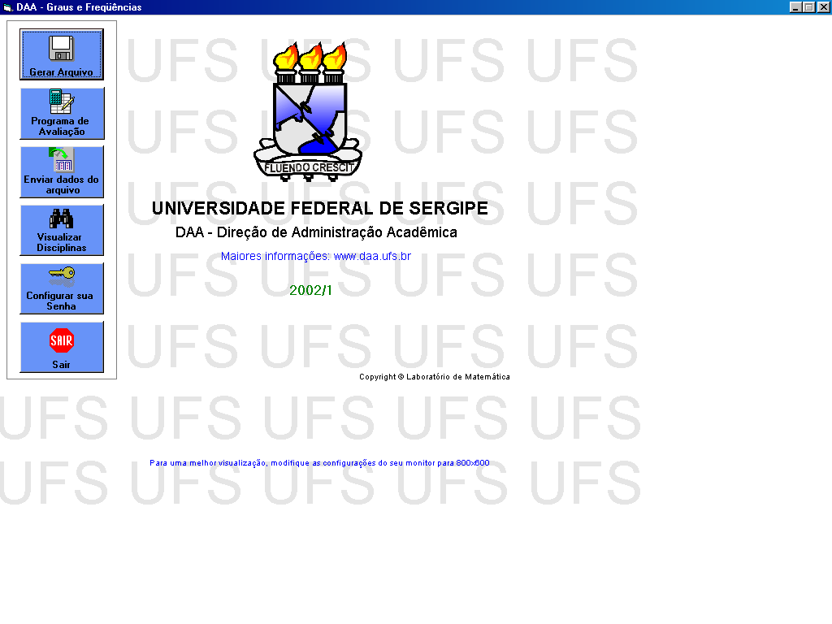
Acknowledgements
Tom Littleford, Scott Walker (Keele)
Mark Read (Birmingham)
Mário Valerio, Jomar Amaral, Marcos Rezende (UFS, Brazil)
Thorsten Schumm (TUWien)
Eric Hudson (UCLA)

Slide 3
Talk contents
Introduction & motivation
Methodology
Modelling dopants in mixed metal fluorides & oxides
Modelling nuclear fuels
Modelling zircon & related materials including radioactive decay products
Modelling concentration dependence of dopants
New projects
Future work

Slide 4
Introduction and motivation
We are interested in using computer modelling to assist in the understanding, design and optimisation of new materials for specific applications.
Applications of current interest are in optical devices, and materials relevant to nuclear energy generation.
We have also applied our methods to some geologically important materials.

Slide 5
Methodology
The calculations described today are all based on the use of empirically derived potentials to describe interactions between ions, and methods based on energy minimisation to determine structures and lattice properties.
We have a long term aim to use quantum mechanics for some specific problems, which will be mentioned at the end of the talk.

Slide 6
Interatomic potentials
Interatomic potentials are simple mathematical functions that describe the interactions between atoms.
For ionic materials we are describing interionic interactions, and the Buckingham potential is usually used, supplemented by an electrostatic term:
V(r) =q₁q₂/r + A exp (-r/ρ) – Cr⁻⁶

Slide 7
Empirical fitting
In the Buckingham potential, the parameters A, ρ and C must be provided, and they are normally obtained by empirical fitting. The q₁ and q₂ are charges of the interacting ions.
Empirical fitting involves varying the parameters until the minimum energy structure and properties they predict corresponds to the experimental values.

Slide 8
Empirical fitting case study
An example of detailed potential fitting is available:
  M S D Read, R A Jackson, Journal of Nuclear Materials, 406 (2010) 293–303
In this paper, the potential is fitted to the structure and lattice properties of UO₂.

Slide 9
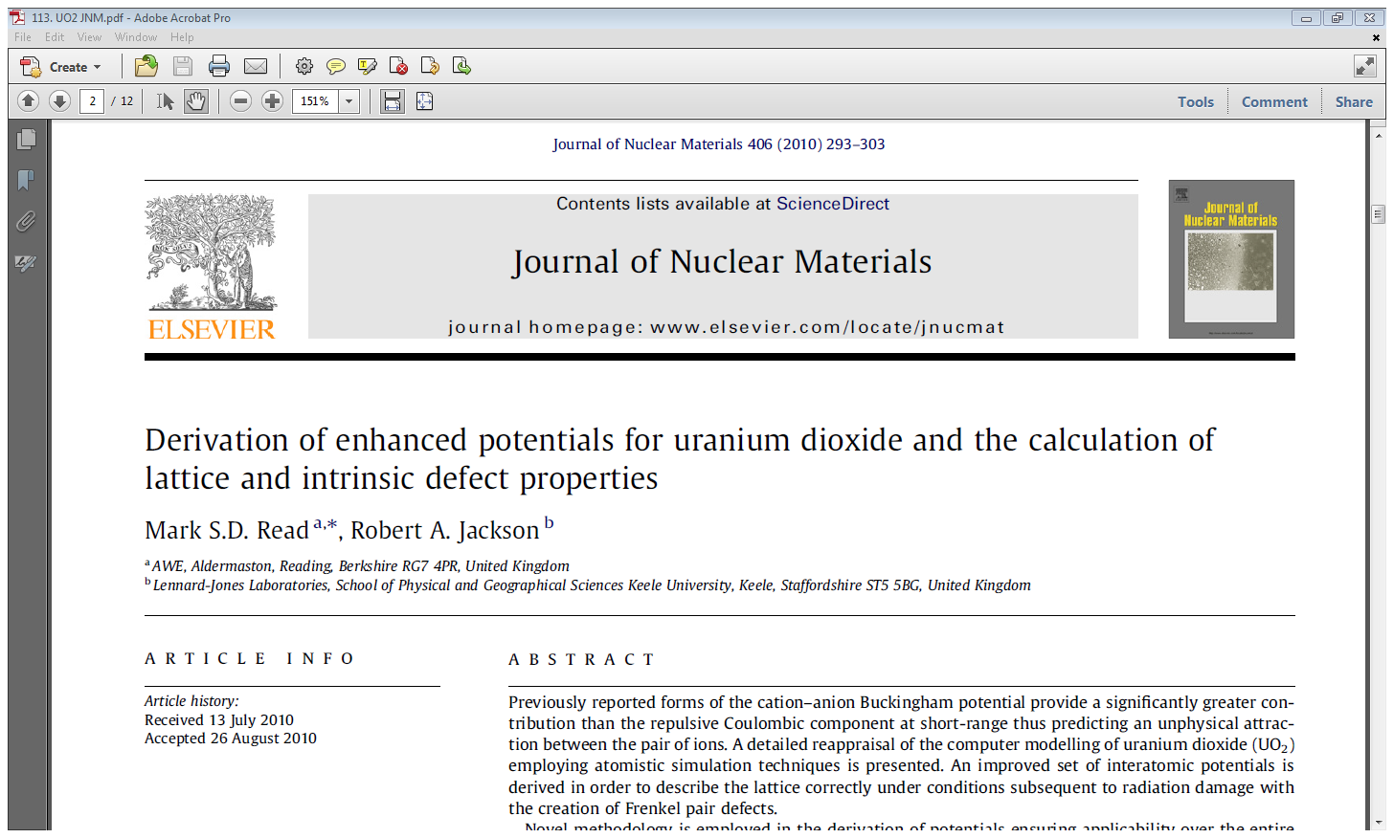

Slide 10
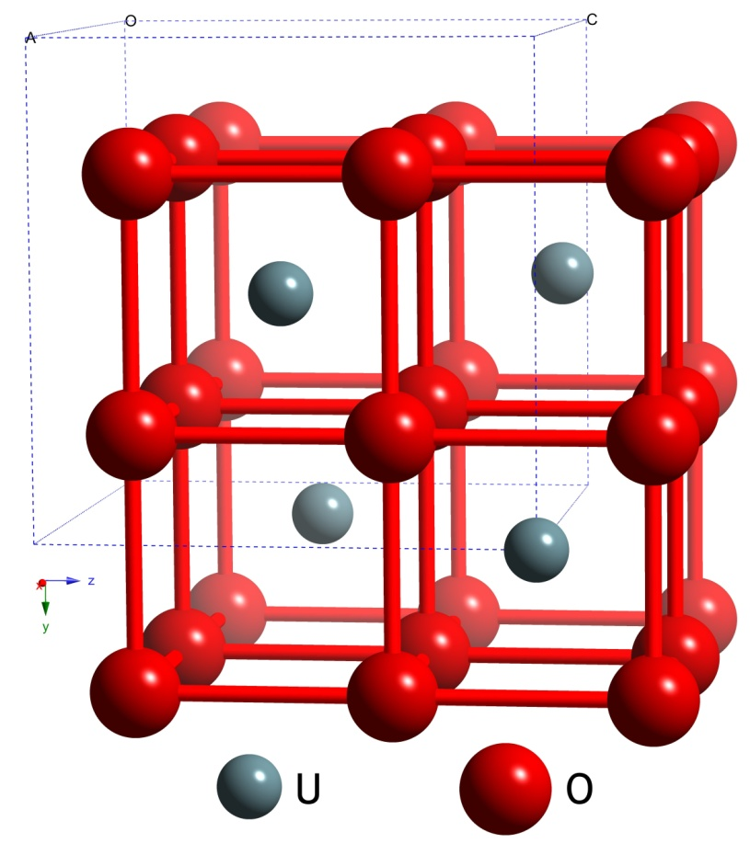
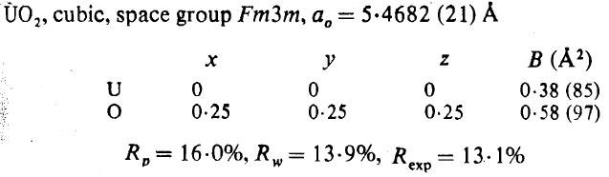
UO₂ Experimental Data
Elastic Constants / GPa
Reference | C₁₁ | C₁₂ | C₄₄
Dolling et al. [1] | 401 ± 9 | 108 ± 20 | 67 ± 6
Wachtman et al. [2] | 396 ± 1.8 | 121 ± 1.9 | 64.1 ± 0.17
Fritz [3] | 389.3 ± 1.7 | 118.7 ± 1.7 | 59.7 ± 0.3
Dielectric Constants
Reference | Static ε₀ | High Frequency ε∞
Dolling et al. [1] | 24 | 5.3
[1] G. Dolling, R. A. Cowley, A. D. B. Woods, Crystal Dynamics of Uranium Dioxide,
Canad. J. Phys. 43 (8) (1965) 1397–1413.
[2] J. B. Wachtman, M. L. Wheat, H. J. Anderson, J. L. Bates, Elastic Constants of Single Crystal UO₂ at 25°C, J. Nucl. Mater. 16 (1) (1965) 39–41.
[3] I. J. Fritz, Elastic Properties of UO₂ at High-Pressure,
J. Appl. Phys. 47 (10) (1976) 4353–4358.
S. A. Barrett, A. J. Jacobson, B. C. Tofield, B. E. F. Fender, The Preparation and Structure of Barium Uranium Oxide BaUO_{3+x}, Acta Cryst. 38 (Nov) (1982) 2775–2781.

Slide 11
How good is the final fit?
(More details in paper)
Parameter | Calc. | Obs. | Δ% | Parameter | Calc. | Obs. | Δ%
Lattice Constant [Å] | 5.4682 | 5.4682 | 0.0 | C₁₁ [GPa] | 391.4 | 389.3 | 0.5
U⁴⁺ – U⁴⁺ Separation [Å] | 3.8666 | 3.8666 | 0.0 | C₁₂ [GPa] | 116.7 | 118.7 | -1.7
U⁴⁺ – O²⁻ Separation [Å] | 2.3678 | 2.3678 | 0.0 | C₄₄ [GPa] | 58.1 | 59.7 | -2.7
O²⁻ – O²⁻ Separation [Å] | 2.7341 | 2.7341 | 0.0 | Bulk Modulus [GPa] | 208.3 | 204.0 | 2.1
Static Dielectric Constant | 24.8 | 24.0 | 3.3 | High Frequency Dielectric Constant | 5.0 | 5.3 | -5.7
Note that it is unusual to have this amount of data to fit to!

Slide 12
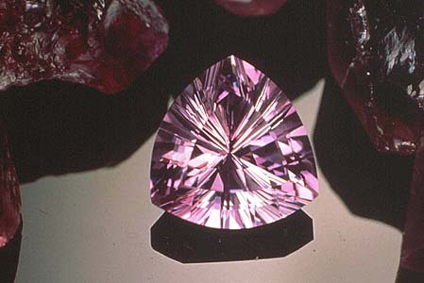
Defects in materials
Most interesting properties are due to the presence of defects!
The picture shows a sample of amethyst, which is quartz, SiO₂ doped with Fe³⁺ ions from Fe₂O₃.
The value of the quartz is drastically increased by the presence of a very small number of Fe³⁺ ions!

Slide 13
Defect calculations
We are mainly interested in:
  Calculation of energies of formation of defects
  Modelling ion migration
  Modelling doping in crystals
    Calculating substitution and solution energies
    Determining location of dopants
    Determining dopant concentrations (new)
Point defect calculations generally use the Mott-Littleton approximation:

Slide 14
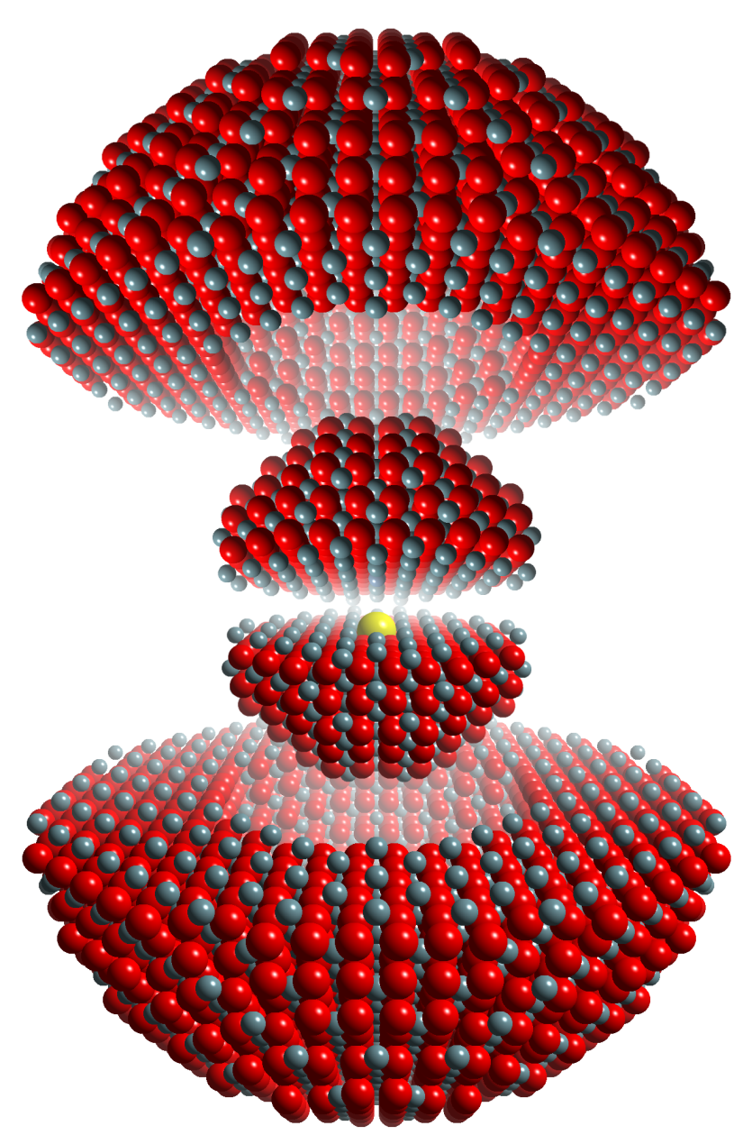
Mott-Littleton approximation
© Mark Read
Region I
Ions are strongly perturbed by the defect and are relaxed explicitly with respect to their Cartesian coordinates.
Region II
Ions are weakly perturbed and therefore their displacements, with the associated energy of relaxation, can be approximated.
Defect
Region I
Region IIa

Slide 15
Substitution and solution energies
Substitution energies are the energies involved in substituting an ion into the material, but they do not take into account all the energetic terms involved in the solution process.
Solution energies include all these terms, so they can be used to determine where the ion will substitute, and what form of charge compensation will occur (if it is needed).

Slide 16
Application: nuclear clocks
²²⁹Th is being investigated for use in ‘nuclear clocks’; its first nuclear excited state is (unusually) only ~ 8 eV above the ground state, and can be probed by VUV radiation.
Nuclear clocks promise up to 6 orders of magnitude improvement in precision over next generation atomic clocks, as well as enhanced stability.
Th has to be doped into a suitable crystal.

Slide 17
Candidate crystals for Th doping
LiCaAlF₆ and LiSrAlF₆ are being investigated, as is CaF₂.
This is a collaboration with two groups, in UCLA and Vienna, where crystal growth is being carried out.
²²⁹Th costs $50k/mg, so the cheaper 232 isotope is being used initially!

Slide 18
Case study: modelling Th⁴⁺ in LiCaAlF₆
Aim: to illustrate all the steps involved in a study of doping a material.
  Derive and test a potential for LiCaAlF₆.
  Derive and test a potential for ThF₄.
  From defect calculations, determine preferred location of Th⁴⁺, and the charge compensation involved.

Slide 19
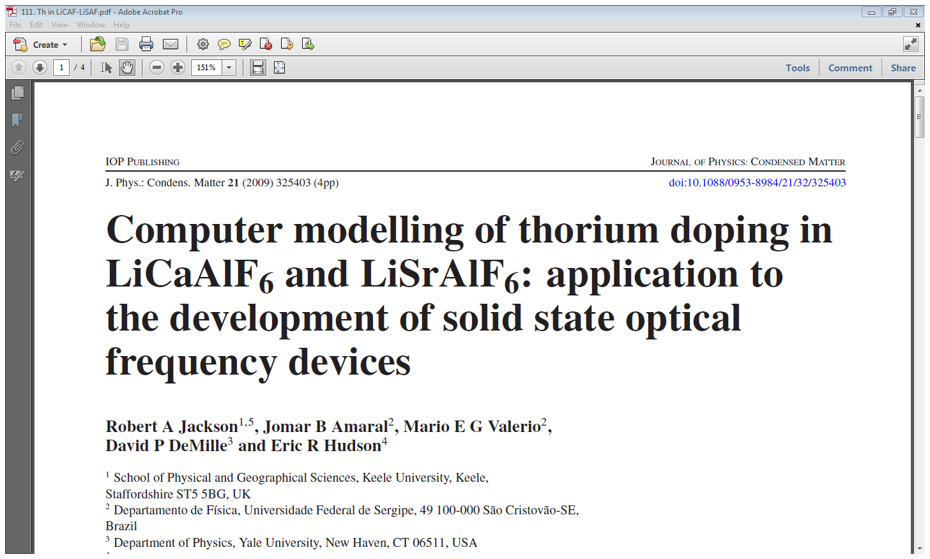
Journal of Physics: Condensed Matter 21 (2009) 325403

Slide 20
1. Modelling LiCaAlF₆*
A potential was previously fitted to the LiCaAlF₆ structure; parameters are given in the reference below.
Good structural agreement was obtained:
*Journal of Physics: Condensed Matter 15 (2003) 2523–2533
Parameter | Experimental | Calculated | % difference
a = b (Å) | 5.01 | 5.03 | 0.42
c (Å) | 9.64 | 9.62 | -0.24
γ (deg) | 120.0 | 120.0 | 0.0

Slide 21
2. Modelling ThF₄
A potential was fitted to the ThF₄ structure, giving agreement as shown below:
[1] G Benner and B G Mueller, Zeitschrift für Anorganische und Allgemeine Chemie 588 (1990) 33-42
Potential parameters are given in the 2009 JPCM reference (slide 19).

Slide 22
3. Where does Th substitute in LiCaAlF₆?
Whichever cation site Th⁴⁺ substitutes at in this material, charge compensation will be needed.
10 possible reaction schemes were considered, and solution energies were calculated for each one.
The lowest energy scheme involves substitution at the Ca²⁺ site, with charge compensation by 2 fluorine interstitial ions:
  ThF₄ + Ca_{Ca} → Th_{Ca}.. + 2F_{i}’ + CaF₂

Slide 23
Solution energies (eV) for different solution schemes
Charge compensation by vacancies
1.95 | 1.96 | 2.84 | 2.15 | 1.20 | 1.47 | 1.95
Charge compensation by interstitials
½ ½ 0 | ½ 0 0 | ¼ ¼ 0 | ¾ ½ 0 | ½ ½ 0 ½ 0 0 | ½ ½ 0 ¼ ¼ 0 | ½ ½ 0 ¾ ½ 0 | ½ 0 0 ¼ ¼ 0 | ½ 0 0 ¾ ½ 0 | ¼ ¼ 0 ¾ ½ 0
2.36 | 2.43 | 2.46 | 2.24 | 0.97 | 1.00 | 0.83 | 1.08 | 0.98 | 0.96

Slide 24
Conclusions on case study
From solution energy calculations, Th⁴⁺ is predicted to substitute at the Ca²⁺ site, with charge compensation by F⁻ interstitials.
This is an important result because of the possible effects of charge compensating defects on the optical properties of the doped material.
Crystal growth is in progress, using ²³²Th initially.

Slide 25
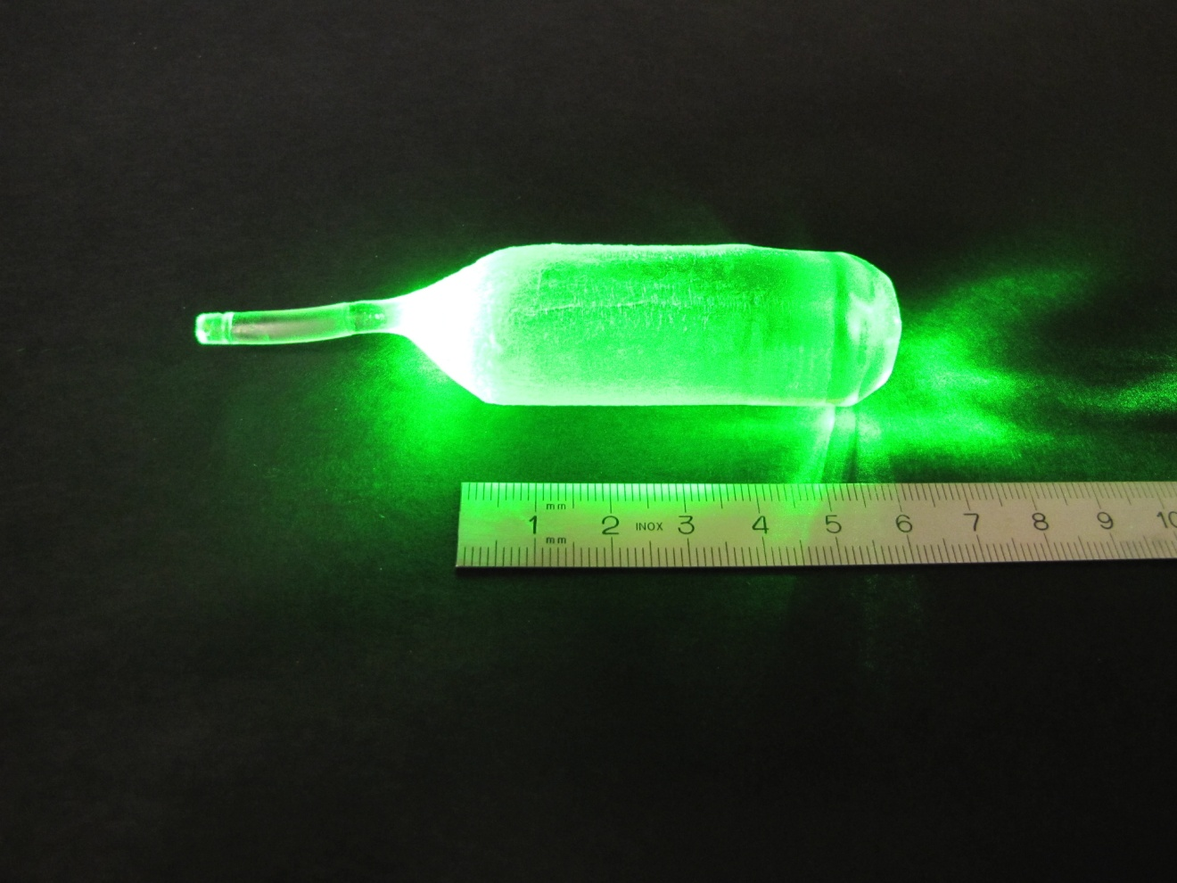


²³²Th doped CaF₂: see http://www.thorium.at/?p=481
Th-CaF₂ project*
Green because of the colour of the laser pointer!
²²⁹Thorium-doped calcium fluoride for nuclear laser spectroscopy:
P Dessovic, P Mohn, R A Jackson, G Winkler, M Schreitl, G Kazakov and T Schumm, JPCM 2014 in press

Slide 26
Modelling pure & defective surfaces of mixed metal fluorides
(Tom Littleford’s PhD)
Surfaces and crystal morphologies may be modelled using the METADISE code written by Steve Parker.
Morphologies can be calculated based on surface or attachment energies, giving equilibrium or growth morphologies.
Dopants can then be added at surfaces and their effect on morphology assessed.

Slide 27
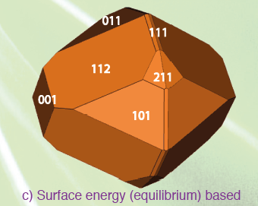

YLF Morphology

Slide 28
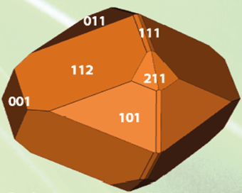
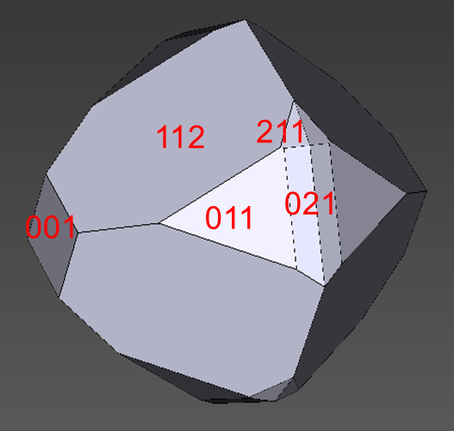
YLF morphology as affected by Ce dopants
Ce-YLF

Slide 29
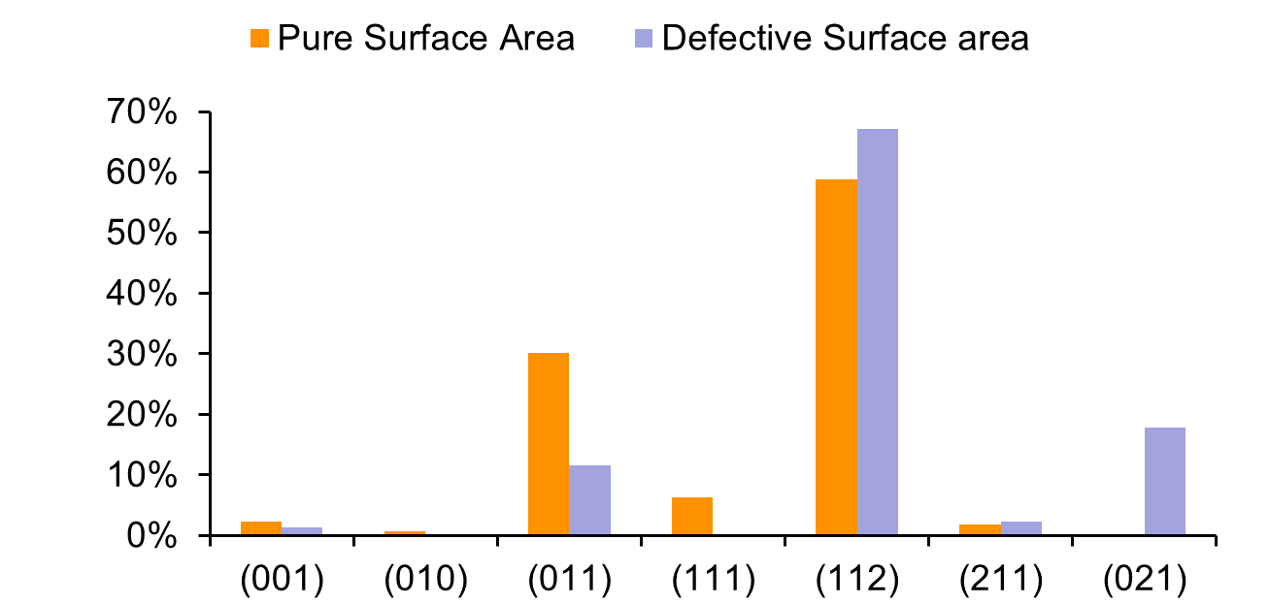
Relative effect on surfaces
The presence of Ce modifies the morphology as shown. The (011) surface becomes less prominent with the (111) surface disappearing altogether. The 021 surface is stabilised by Ce dopants and therefore appears in the defective morphology.

Slide 30
Modelling nuclear fuels
(Scott Walker’s PhD)
The derivation of a potential for UO₂ has already been discussed.
Having previously worked on nuclear materials in the 1980s, interest in nuclear power has returned (at least in some countries!), and there is new motivation for research.
We are studying UO₂ and PuO₂, and the mixed oxide MOX.
A paper describing the derivation of a potential for PuO₂ has just been accepted for publication.

Slide 31
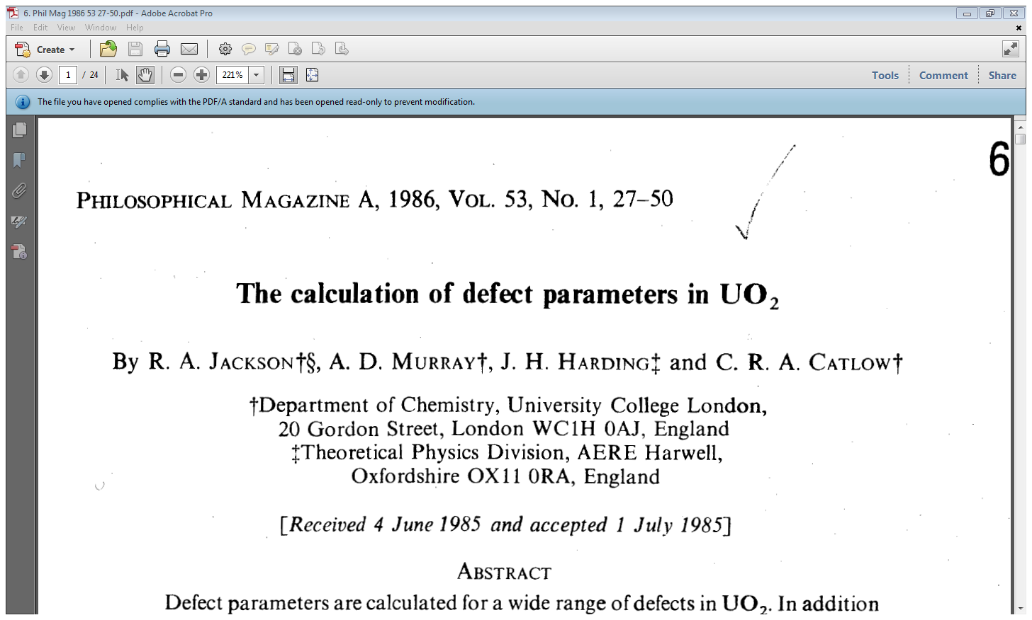
History!

Slide 32
Approaches to modelling MOX (& doped materials)
We use two approaches to model materials with a finite dopant concentrations:
  the Mean Field method, which assumes an average occupancy of the dopant ion
  the Supercell method, in which the dopant ions are substituted for host ions in a supercell
The second method is more flexible, allowing different configurations of dopants, and might be expected to give more reliable results.

Slide 33
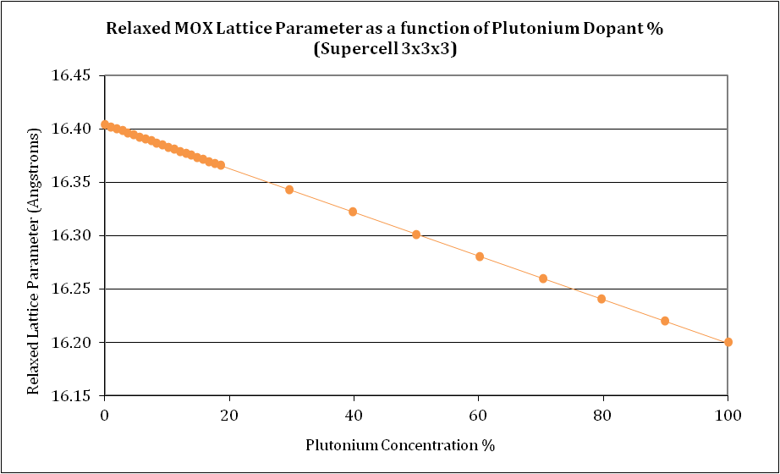

Mean Field vs. Supercell Approach
The MOX system UO₂/PuO₂ was modelled for a range of Pu concentrations allowing the variation of lattice parameter with Pu concentration to be predicted. As expected, lattice parameter decreases linearly with increasing Pu concentration
Two methods were employed in this particular study. The first a Mean Field method which considers an average Pu occupancy at each U site; the second a Supercell method, where Pu ions are explicitly substituted for U ions in the cell. Both produce the same result.

Slide 34
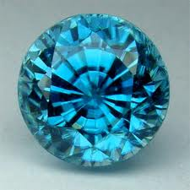
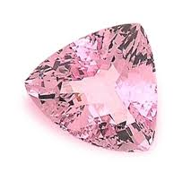
Modelling zircon and related materials
Zircon, ZrSiO₄, readily accommodates U at the Zr site, and the fully substituted compound, USiO₄, is the mineral coffinite.
Starting with zircon and progressively substituting U at the Zr site allows the structure of coffinite to be predicted, and the result can be compared with the experimental structure:

Slide 35
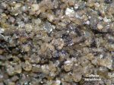
Structure prediction of coffinite
Predicted coffinite structure
 | Exp (Å) | Calc (Å) | %
a=b | 6.995 | 6.874 | -1.8
c | 6.262 | 6.371 | -1.7
The structure is predicted to better than -2%
Structures for the full range of solid solutions can be calculated.
Black, interstitial coffinite cementing a sub-angular quartzose sandstone. Schumacher Coll.
(Temple Mountain, San Rafael District (San Rafael Swell), Emery Co., Utah, USA)

Slide 36
Coffinite and radioactive decay
 | PbSiO₄
 | Exp (Å) | Calc (Å) | %
a=b | ? | 6.489
c | ? | 6.102
²³⁸U decays radioactively to ²⁰⁶Pb (see next slide).
Due to the long t_{1/2} of U (& subsequent nuclides), oldest samples of coffinite have ~ 3% Pb.
However, the structure of the end member, PbSiO₄, can be predicted, as can the full Pb-U solid solution.
Experimental data may take a while to obtain (:
Attempted synthesis of PbSiO₄ (Keelite) is being attempted!

Slide 37
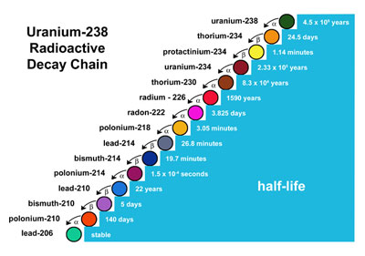
²³⁸U decay series

Slide 38
Modelling concentration dependence of doping
Motivation – for optical materials, dopants are responsible for their important properties
We can predict where they substitute in the lattice, and what form of charge compensation will be preferred.
We would like to be able to predict how much dopant can be added!
We are developing a method to do this …

Slide 39
Explanation of method
(i)
Consider doping YLiF₄ (YLF) with M³⁺ dopants:
(1-x) YF₃ + xMF₃ + LiF → Y_{1-x}M_{x}LiF₄
The procedure is to calculate the energy of this reaction as a function of the dopant concentration x. This gives:
E_{sol} = E (Y_{1-x}M_{x}LiF₄) – [(1-x) E_{latt}(YF₃)+ xE_{latt}(MF₃)+ E_{latt}(LiF)]
The correct way to calculate the first term in this equation has taken a lot of thought!

Slide 40
Explanation of method
(ii)
The term is calculated using this expression:
E_{D}(x) = x E_{D}^{ML} + E_{p}(1)
This splits the energy into defective and perfect terms (and assumes they don’t interact).
The final expression is then:
E_{sol} = E (xE_{D}^{ML} + E_{latt}(YLiF₄) – [(1-x) E_{latt}(YF₃)+ xE_{latt}(MF₃)+ E_{latt}(LiF)]
The method has been tested:

Slide 41
Defect concentration results*
RE | Max % MF₃ | RE | Max % MF₃
La | 0.69 | Tb | 1.41
Ce | 0.76 | Dy | 1.28
Pr | 0.85 | Ho | 1.40
Nd | 0.93 | Er | 1.52
Sm | 1.23 | Tm | 1.33
Eu | 1.15 | Yb | 1.51
Gd | 1.22 | Lu | 1.49
The results show a general increase in max. defect concentration with atomic number.
We are looking for experimental results to test this method on…
Supercell methods can also be used to calculate the RHS term.
* Tom Littleford: unpublished results

Slide 42
Recently started projects
Modelling of Na(B(OH)₄) – deriving a potential to model the structure and properties of the material.
  Z Assi, C Rüscher (Hannover)
Modelling of laser cooling in TM-doped YLiF₄.
  M P Hehlen (Los Alamos NL)
Modelling of finite dopant concentrations in LiNbO₃
  M E G Valerio (UFS), G Borchardt, P Fielitz (Clausthal)

Slide 43
Future work
Further development of the dopant concentration work.
We are interested in calculating the electronic structure of dopants in optical materials, with a view to predicting energy transitions.
This has already been done with crystal field methods, but the ultimate aim is to use embedded cluster quantum mechanical approaches.

Slide 44

Some information about a future conference of possible interest!

Slide 45
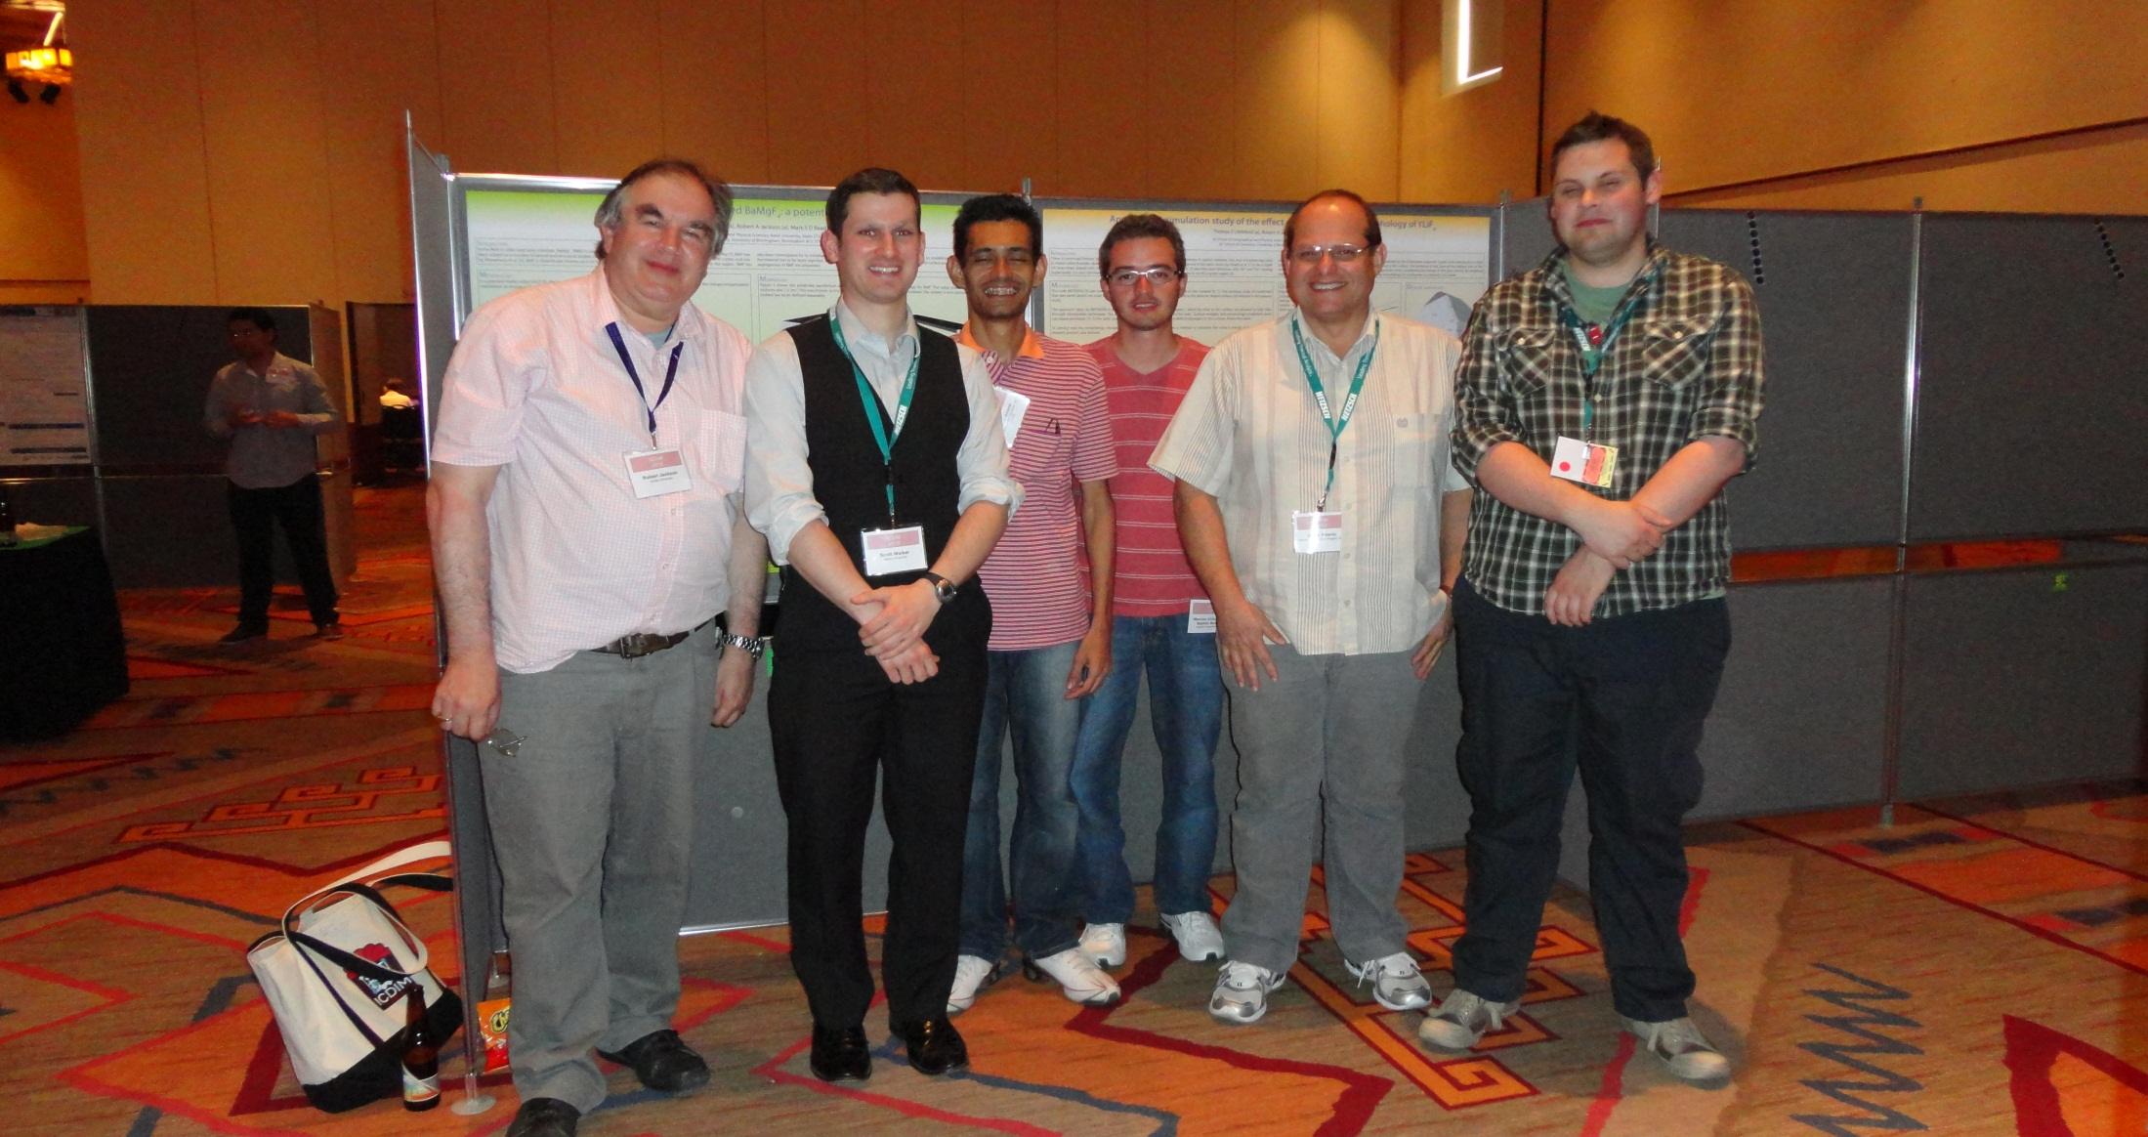
Some of the team

Slide 46


Thank you!
28/11/12

